Slide 1
Notes:
The notes that accompany these example slides form a guideline to producing successful presentations and working effectively with the template. A number of slide layout masters have been created to allow switching between different slide styles; by ‘right-clicking’ a slide you can ‘apply’ a different slide layout (the content of which needs to be applicable to the layout you are choosing).
Printing your presentation in ‘black and white’ will avoid overuse of colour toners – you can preview the ‘black and white’ appearance by choosing the option under the ‘View’ tab in PowerPoint®.
General principles
Guides have been added to assist with the correct placement of all presentation elements (text and graphics) – please work within the slide margins and use the guides wherever possible. By following the example slides you will see how elements are positioned. Text should not be resized or distorted to fit; if your content won’t fit on a single slide, use an additional slide instead. Remember… slides should be a prompt for the presenter and not filled with copy for reading out in full.
Opening slide [uses Holding Slide layout]
This slide is intended as an introductory ‘opening’ slide and should not include any additional text or graphics. The same slide layout is used as a presentation closing slide. The brand mark and data art graphic on this slide layout are set up at the correct size and position and should not be altered.

Slide 2
Osservatorio Credit & Mobility
Novembre 2024
Notes:
Closing slide [uses Holding Slide layout]
This slide can be used as a ‘closing’ slide and should not include any additional text or graphics. The same slide layout is used as a presentation opening slide. The brand mark and data art graphic on this slide layout are set up at the correct size and position and should not be altered.

Slide 3
Considerazioni 1/2
Osservatorio Credit & Mobility Experian UNRAE – Novembre 2024
Mercato Auto Nuova, Leasing e Renting
Il 2023 ha segnato la ripresa del mercato. Il 2024 sta riscontrando una lieve crescita sia sulle immatricolazioni che richieste di finanziamento, rispettivamente i primi 9 mesi del 2024 vedono un +1.9% e +3.8%
Come possiamo vedere dagli andamenti, le variazioni di richieste di finanziamento auto nuove/usate sono precursori dei movimenti relativi a immatricolazioni e trasferimenti di proprietà. I trend delle prime precedono quelli delle seconde con un range temporale di circa 3-5 mesi
Interessante notare come non sempre le regioni con più immatricolazioni sono quelle con più richieste e viceversa: la penetrazione delle richieste di finanziamento è infatti estremamente diversa fra una regione e l’altra.
Le richieste di finanziamento coprono solo una parte dell’importo di acquisto, ossia non tutto il valore dell’auto viene finanziato, considerando anticipo e maxi rata finale, quindi richieste di importi minori riguardano anche immatricolazioni di veicoli con fascia di prezzo più alto. Ad esempio, per le auto nuove, nel 2024 le fasce di prezzo fino a 25.000€ rappresentano il 50% delle immatricolazioni e il 61% delle richieste di finanziamento
Nei 9 mesi in leggera flessione le immatricolazioni a società (-2,9%), tra queste il noleggio cala del 10%
Crescono le richieste e le immatricolazioni in tutte le fasce di età, tranne i giovanissimi tra i 18-29 anni che per immatricolazioni registrano un -3.1% e per le richieste un -0.8%
La fascia 46-60 anni copre quasi il 40% del mercato sia per le richieste di finanziamento che per le immatricolazioni
L’importo della maxi rata finale per i contratti di finanziamento auto nuove è in aumento rispetto all’anno precedente. Forte crescita per importi superiodi a 20 mila euro
Notes:
Text slide [uses Title and Content layout]
The headline appears in Arial (Experian Dark Blue) at 34pt. If a subheadline is required, it should be manually sized to 20pt.
The text has five pre-set levels in 17pt Arial, to a maximum width of 23.4cm:
Level 1 – ranged to the left margin for continuous text; if you require a bold subheading you can embolden this to 17pt Arial Bold
Level 2 – ranged to the left text margin with a round bullet, subsequent lines aligning with the text of the previous line
Level 3 – horizontal dash bullet, subsequent lines aligning with the text of the previous line
Level 4 – round bullet, subsequent lines aligning with the text of the previous line
Level 5 –horizontal dash bullet, subsequent lines aligning with the text of the previous line
Advancing through the text levels can be done by using the ‘Increase List Level’ and ‘Decrease List Level’ buttons in the ‘Paragraph’ tools on the ‘Home’ ribbon.
If your text content exceeds the depth of the text box, you may need to consider creating an additional slide.
The brand mark on this slide layout is set up at the correct size and position and should not be altered. The date and footer info can be edited across all slides by using the ‘Header and Footer’ settings on the ‘Insert’ ribbon (do not edit these manually on the individual slides).

Slide 4
Considerazioni 2/2
Osservatorio Credit & Mobility Experian UNRAE – Novembre 2024
Mercato Auto Usata
Auto usata: crescono maggiormente le richieste e trasferimenti di proprietà da parte delle donne, in calo le società
Nel 9 mesi 2024 il mercato dell’auto usata è in crescita, con i trasferimenti di proprietà a +6.7%, ma le richieste di finanziamento aumentano del 10.9%. Come per il mercato dell’auto nuova, anche per l’auto usata la fascia di età 46 – 60 anni copre la fetta più grande del mercato (circa il 36%)
In aumento del 14.5% le richieste di finanziamento con durata oltre i 5 anni
Mercato Veicoli Commerciali
Continua la contrazione delle durate del finanziamento in questo 9 mesi 2024, e crescono solamente gli importi delle richieste di finanziamento fino a 15.000€
Il settore dei veicoli commerciali è quello che prevede meno richieste di finanziamento, gli importi di acquisto dei mezzi e delle richieste di finanziamento mediamente sono più bassi rispetto agli altri settori
Notes:
Text slide [uses Title and Content layout]
The headline appears in Arial (Experian Dark Blue) at 34pt. If a subheadline is required, it should be manually sized to 20pt.
The text has five pre-set levels in 17pt Arial, to a maximum width of 23.4cm:
Level 1 – ranged to the left margin for continuous text; if you require a bold subheading you can embolden this to 17pt Arial Bold
Level 2 – ranged to the left text margin with a round bullet, subsequent lines aligning with the text of the previous line
Level 3 – horizontal dash bullet, subsequent lines aligning with the text of the previous line
Level 4 – round bullet, subsequent lines aligning with the text of the previous line
Level 5 –horizontal dash bullet, subsequent lines aligning with the text of the previous line
Advancing through the text levels can be done by using the ‘Increase List Level’ and ‘Decrease List Level’ buttons in the ‘Paragraph’ tools on the ‘Home’ ribbon.
If your text content exceeds the depth of the text box, you may need to consider creating an additional slide.
The brand mark on this slide layout is set up at the correct size and position and should not be altered. The date and footer info can be edited across all slides by using the ‘Header and Footer’ settings on the ‘Insert’ ribbon (do not edit these manually on the individual slides).

Slide 5
Mercato auto nuova, leasing e renting
Immatricolazioni e richieste di finanziamento
Notes:
The notes that accompany these example slides form a guideline to producing successful presentations and working effectively with the template. A number of slide layout masters have been created to allow switching between different slide styles; by ‘right-clicking’ a slide you can ‘apply’ a different slide layout (the content of which needs to be applicable to the layout you are choosing).
Printing your presentation in ‘black and white’ will avoid overuse of colour toners – you can preview the ‘black and white’ appearance by choosing the option under the ‘View’ tab in PowerPoint®.
General principles
Guides have been added to assist with the correct placement of all presentation elements (text and graphics) – please work within the slide margins and use the guides wherever possible. By following the example slides you will see how elements are positioned. Text should not be resized or distorted to fit; if your content won’t fit on a single slide, use an additional slide instead. Remember… slides should be a prompt for the presenter and not filled with copy for reading out in full.
Opening slide [uses Holding Slide layout]
This slide is intended as an introductory ‘opening’ slide and should not include any additional text or graphics. The same slide layout is used as a presentation closing slide. The brand mark and data art graphic on this slide layout are set up at the correct size and position and should not be altered.

Slide 6
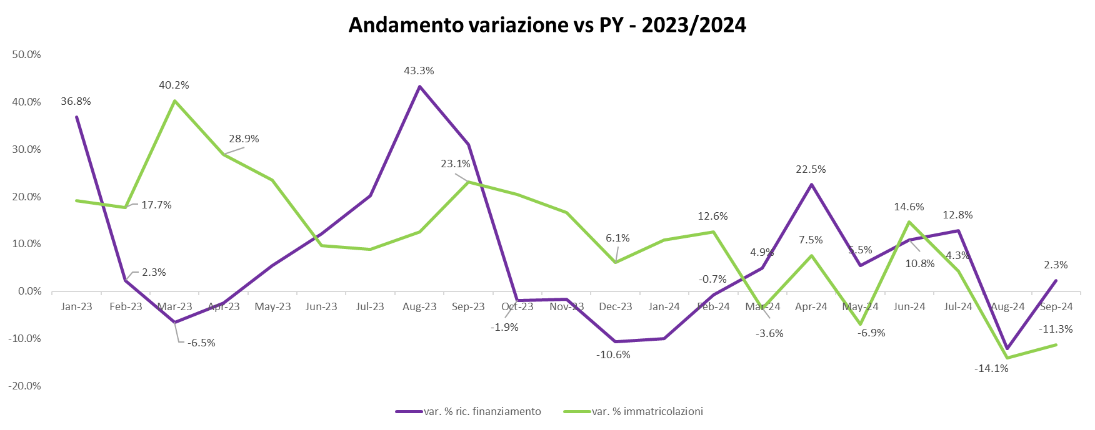
Osservatorio Credit & Mobility
Credito e Immatricolazioni
Mercato auto nuova, leasing e renting
Non è presente un legame diretto tra immatricolazioni e richieste di finanziamento dello stesso mese
Notes:
Text and graph slide [uses Title and Two Content layout]
The headline appears in Arial (Experian Dark Blue) at 34pt. If a subheadline is required, it should be manually sized to 20pt.
The text has five pre-set levels in 17pt Arial:
Level 1 – ranged to the left margin for continuous text; if you require a bold subheading you can embolden this to 17pt Arial Bold
Level 2 – ranged to the left text margin with a round bullet, subsequent lines aligning with the text of the previous line
Level 3 – horizontal dash bullet, subsequent lines aligning with the text of the previous line
Level 4 – round bullet, subsequent lines aligning with the text of the previous line
Level 5 –horizontal dash bullet, subsequent lines aligning with the text of the previous line
Advancing through the text levels can be done by using the ‘Increase List Level’ and ‘Decrease List Level’ buttons in the ‘Paragraph’ tools on the ‘Home’ ribbon.
If your text content exceeds the depth of the text box, you may need to consider creating an additional slide.
Working with graphs
The ‘Design’ ribbon in PowerPoint® shows a number of available graph options which are based on the colour theme of the template – always try to select a graph option and style which best communicates the data being presented. The graph ‘Design’ and ‘Format’ ribbons become available when the table has been selected, providing tools and controls directly within PowerPoint® which enable restyling and formatting of the graphic.
The brand mark on this slide layout is set up at the correct size and position and should not be altered. The date and footer info can be edited across all slides by using the ‘Header and Footer’ settings on the ‘Insert’ ribbon (do not edit these manually on the individual slides).

Slide 7
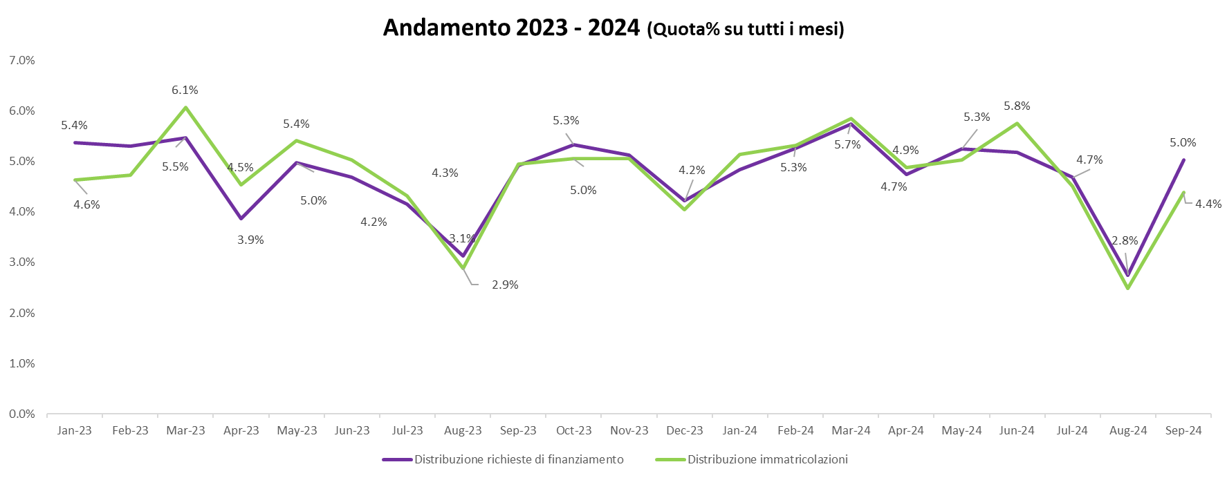
Osservatorio Credit & Mobility
Credito e Immatricolazioni
Mercato auto nuova, leasing e renting
Non è presente un legame diretto tra immatricolazioni e richieste di finanziamento dello stesso mese
Notes:
Text and graph slide [uses Title and Two Content layout]
The headline appears in Arial (Experian Dark Blue) at 34pt. If a subheadline is required, it should be manually sized to 20pt.
The text has five pre-set levels in 17pt Arial:
Level 1 – ranged to the left margin for continuous text; if you require a bold subheading you can embolden this to 17pt Arial Bold
Level 2 – ranged to the left text margin with a round bullet, subsequent lines aligning with the text of the previous line
Level 3 – horizontal dash bullet, subsequent lines aligning with the text of the previous line
Level 4 – round bullet, subsequent lines aligning with the text of the previous line
Level 5 –horizontal dash bullet, subsequent lines aligning with the text of the previous line
Advancing through the text levels can be done by using the ‘Increase List Level’ and ‘Decrease List Level’ buttons in the ‘Paragraph’ tools on the ‘Home’ ribbon.
If your text content exceeds the depth of the text box, you may need to consider creating an additional slide.
Working with graphs
The ‘Design’ ribbon in PowerPoint® shows a number of available graph options which are based on the colour theme of the template – always try to select a graph option and style which best communicates the data being presented. The graph ‘Design’ and ‘Format’ ribbons become available when the table has been selected, providing tools and controls directly within PowerPoint® which enable restyling and formatting of the graphic.
The brand mark on this slide layout is set up at the correct size and position and should not be altered. The date and footer info can be edited across all slides by using the ‘Header and Footer’ settings on the ‘Insert’ ribbon (do not edit these manually on the individual slides).

Slide 8
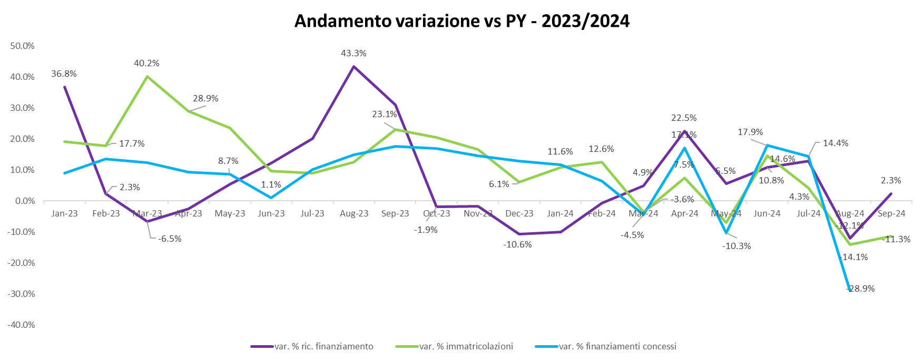
Osservatorio Credit & Mobility
Credito e Immatricolazioni
Mercato auto nuova, leasing e renting
Non è presente un legame diretto tra immatricolazioni e richieste di finanziamento dello stesso mese
Notes:
Text and graph slide [uses Title and Two Content layout]
The headline appears in Arial (Experian Dark Blue) at 34pt. If a subheadline is required, it should be manually sized to 20pt.
The text has five pre-set levels in 17pt Arial:
Level 1 – ranged to the left margin for continuous text; if you require a bold subheading you can embolden this to 17pt Arial Bold
Level 2 – ranged to the left text margin with a round bullet, subsequent lines aligning with the text of the previous line
Level 3 – horizontal dash bullet, subsequent lines aligning with the text of the previous line
Level 4 – round bullet, subsequent lines aligning with the text of the previous line
Level 5 –horizontal dash bullet, subsequent lines aligning with the text of the previous line
Advancing through the text levels can be done by using the ‘Increase List Level’ and ‘Decrease List Level’ buttons in the ‘Paragraph’ tools on the ‘Home’ ribbon.
If your text content exceeds the depth of the text box, you may need to consider creating an additional slide.
Working with graphs
The ‘Design’ ribbon in PowerPoint® shows a number of available graph options which are based on the colour theme of the template – always try to select a graph option and style which best communicates the data being presented. The graph ‘Design’ and ‘Format’ ribbons become available when the table has been selected, providing tools and controls directly within PowerPoint® which enable restyling and formatting of the graphic.
The brand mark on this slide layout is set up at the correct size and position and should not be altered. The date and footer info can be edited across all slides by using the ‘Header and Footer’ settings on the ‘Insert’ ribbon (do not edit these manually on the individual slides).

Slide 9
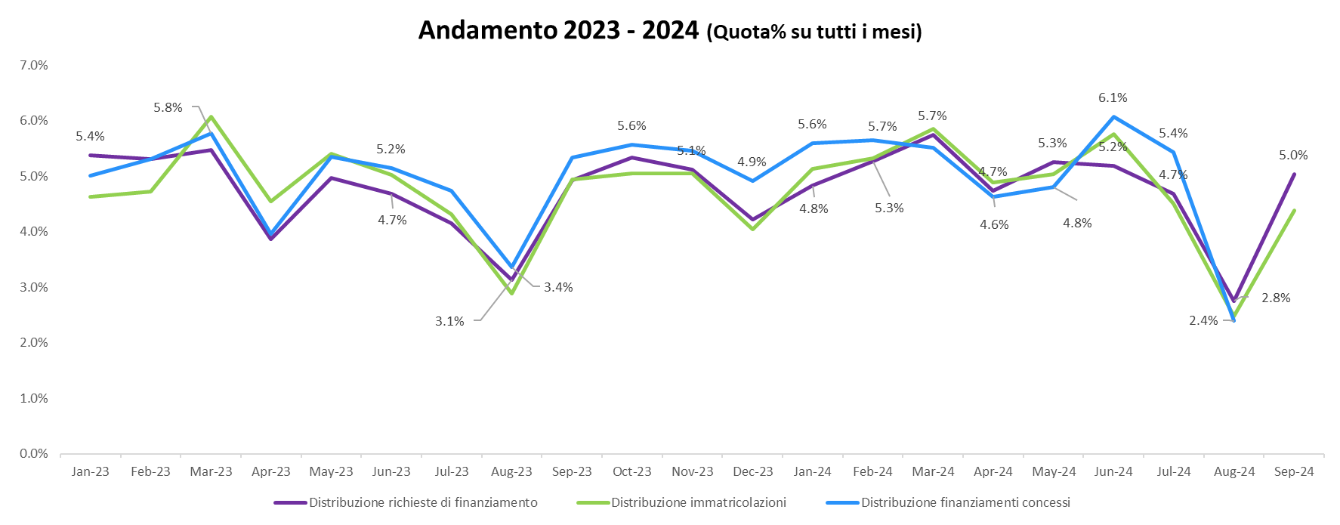
Osservatorio Credit & Mobility
Credito e Immatricolazioni
Mercato auto nuova, leasing e renting
Non è presente un legame diretto tra immatricolazioni e richieste di finanziamento dello stesso mese
Notes:
Text and graph slide [uses Title and Two Content layout]
The headline appears in Arial (Experian Dark Blue) at 34pt. If a subheadline is required, it should be manually sized to 20pt.
The text has five pre-set levels in 17pt Arial:
Level 1 – ranged to the left margin for continuous text; if you require a bold subheading you can embolden this to 17pt Arial Bold
Level 2 – ranged to the left text margin with a round bullet, subsequent lines aligning with the text of the previous line
Level 3 – horizontal dash bullet, subsequent lines aligning with the text of the previous line
Level 4 – round bullet, subsequent lines aligning with the text of the previous line
Level 5 –horizontal dash bullet, subsequent lines aligning with the text of the previous line
Advancing through the text levels can be done by using the ‘Increase List Level’ and ‘Decrease List Level’ buttons in the ‘Paragraph’ tools on the ‘Home’ ribbon.
If your text content exceeds the depth of the text box, you may need to consider creating an additional slide.
Working with graphs
The ‘Design’ ribbon in PowerPoint® shows a number of available graph options which are based on the colour theme of the template – always try to select a graph option and style which best communicates the data being presented. The graph ‘Design’ and ‘Format’ ribbons become available when the table has been selected, providing tools and controls directly within PowerPoint® which enable restyling and formatting of the graphic.
The brand mark on this slide layout is set up at the correct size and position and should not be altered. The date and footer info can be edited across all slides by using the ‘Header and Footer’ settings on the ‘Insert’ ribbon (do not edit these manually on the individual slides).

Slide 10
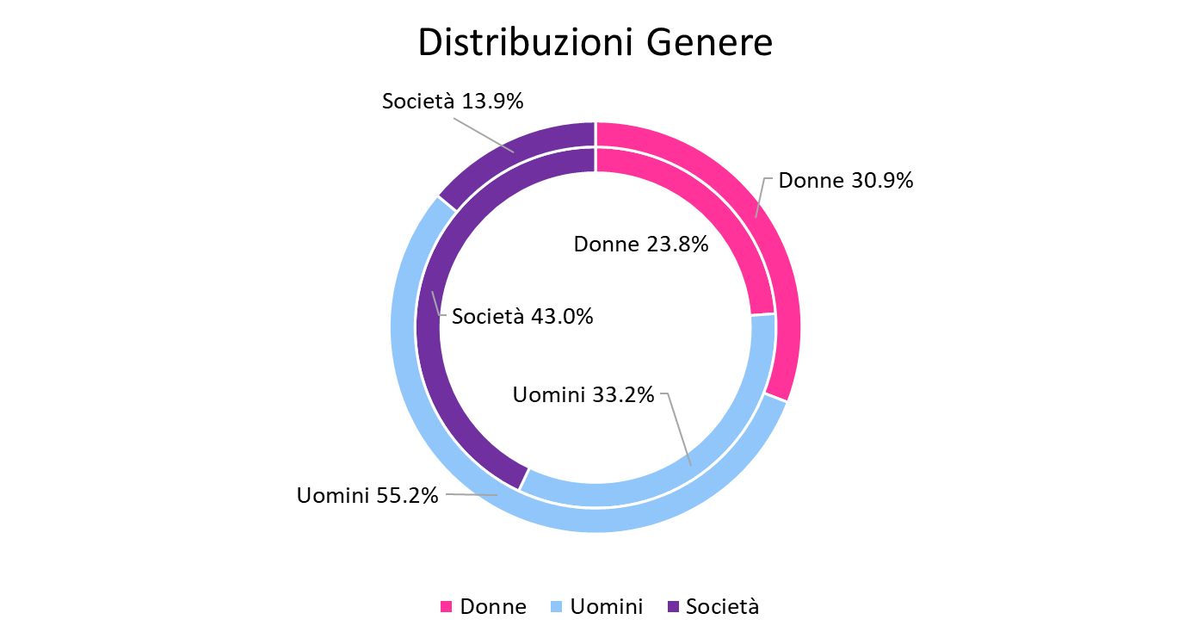
Osservatorio Credit & Mobility
Credito e Immatricolazioni
Mercato auto nuova, leasing e renting
- 9 Mesi 2024
Anello esterno: Richieste di finanziamento
Anello interno: Immatricolazioni
Notes:
Text and graph slide [uses Title and Two Content layout]
The headline appears in Arial (Experian Dark Blue) at 34pt. If a subheadline is required, it should be manually sized to 20pt.
The text has five pre-set levels in 17pt Arial:
Level 1 – ranged to the left margin for continuous text; if you require a bold subheading you can embolden this to 17pt Arial Bold
Level 2 – ranged to the left text margin with a round bullet, subsequent lines aligning with the text of the previous line
Level 3 – horizontal dash bullet, subsequent lines aligning with the text of the previous line
Level 4 – round bullet, subsequent lines aligning with the text of the previous line
Level 5 –horizontal dash bullet, subsequent lines aligning with the text of the previous line
Advancing through the text levels can be done by using the ‘Increase List Level’ and ‘Decrease List Level’ buttons in the ‘Paragraph’ tools on the ‘Home’ ribbon.
If your text content exceeds the depth of the text box, you may need to consider creating an additional slide.
Working with graphs
The ‘Design’ ribbon in PowerPoint® shows a number of available graph options which are based on the colour theme of the template – always try to select a graph option and style which best communicates the data being presented. The graph ‘Design’ and ‘Format’ ribbons become available when the table has been selected, providing tools and controls directly within PowerPoint® which enable restyling and formatting of the graphic.
The brand mark on this slide layout is set up at the correct size and position and should not be altered. The date and footer info can be edited across all slides by using the ‘Header and Footer’ settings on the ‘Insert’ ribbon (do not edit these manually on the individual slides).

Slide 11
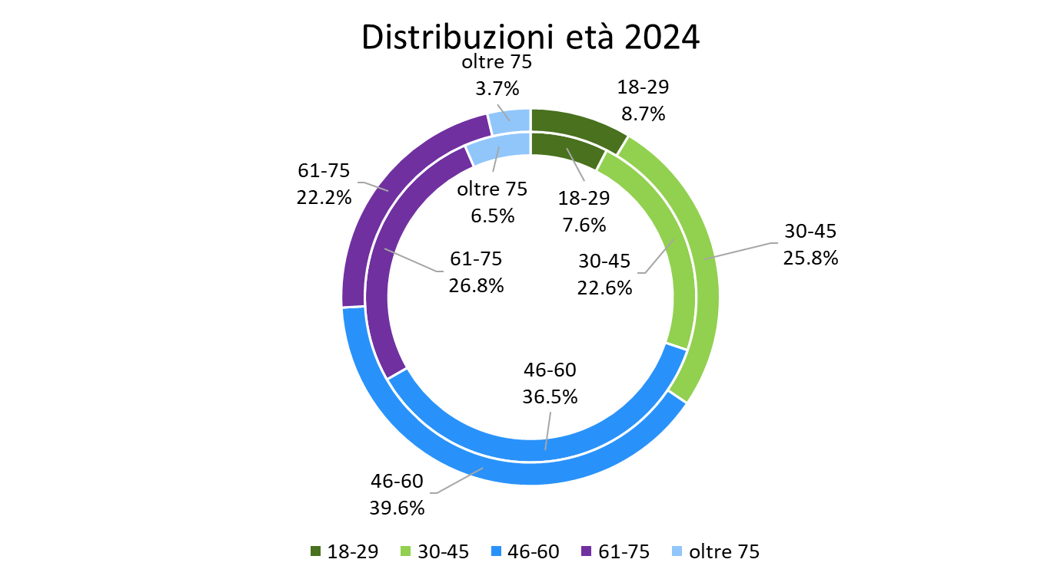
Osservatorio Credit & Mobility
Credito e Immatricolazioni
Mercato auto nuova, leasing e renting
- 9 Mesi 2024
Anello esterno: Richieste di finanziamento
Anello interno: Immatricolazioni
Notes:
Text and graph slide [uses Title and Two Content layout]
The headline appears in Arial (Experian Dark Blue) at 34pt. If a subheadline is required, it should be manually sized to 20pt.
The text has five pre-set levels in 17pt Arial:
Level 1 – ranged to the left margin for continuous text; if you require a bold subheading you can embolden this to 17pt Arial Bold
Level 2 – ranged to the left text margin with a round bullet, subsequent lines aligning with the text of the previous line
Level 3 – horizontal dash bullet, subsequent lines aligning with the text of the previous line
Level 4 – round bullet, subsequent lines aligning with the text of the previous line
Level 5 –horizontal dash bullet, subsequent lines aligning with the text of the previous line
Advancing through the text levels can be done by using the ‘Increase List Level’ and ‘Decrease List Level’ buttons in the ‘Paragraph’ tools on the ‘Home’ ribbon.
If your text content exceeds the depth of the text box, you may need to consider creating an additional slide.
Working with graphs
The ‘Design’ ribbon in PowerPoint® shows a number of available graph options which are based on the colour theme of the template – always try to select a graph option and style which best communicates the data being presented. The graph ‘Design’ and ‘Format’ ribbons become available when the table has been selected, providing tools and controls directly within PowerPoint® which enable restyling and formatting of the graphic.
The brand mark on this slide layout is set up at the correct size and position and should not be altered. The date and footer info can be edited across all slides by using the ‘Header and Footer’ settings on the ‘Insert’ ribbon (do not edit these manually on the individual slides).

Slide 12
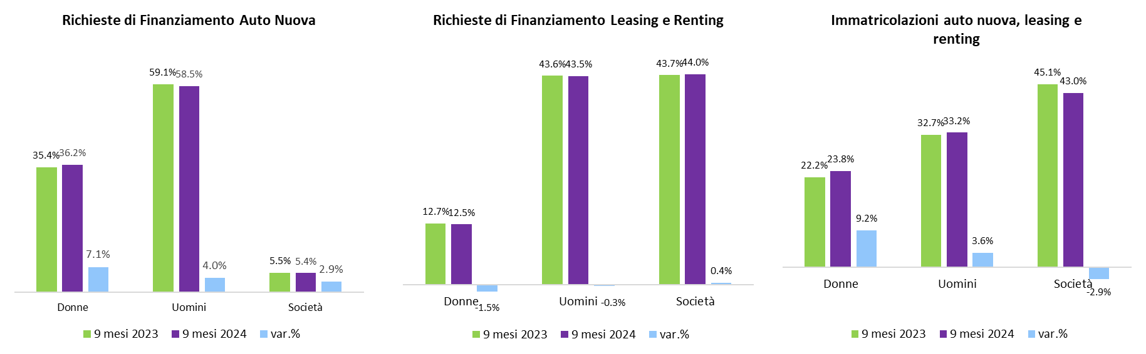
Osservatorio Credit & Mobility
Credito e Immatricolazioni
Mercato auto nuova, leasing e renting
Notes:
Text and graph slide [uses Title and Two Content layout]
The headline appears in Arial (Experian Dark Blue) at 34pt. If a subheadline is required, it should be manually sized to 20pt.
The text has five pre-set levels in 17pt Arial:
Level 1 – ranged to the left margin for continuous text; if you require a bold subheading you can embolden this to 17pt Arial Bold
Level 2 – ranged to the left text margin with a round bullet, subsequent lines aligning with the text of the previous line
Level 3 – horizontal dash bullet, subsequent lines aligning with the text of the previous line
Level 4 – round bullet, subsequent lines aligning with the text of the previous line
Level 5 –horizontal dash bullet, subsequent lines aligning with the text of the previous line
Advancing through the text levels can be done by using the ‘Increase List Level’ and ‘Decrease List Level’ buttons in the ‘Paragraph’ tools on the ‘Home’ ribbon.
If your text content exceeds the depth of the text box, you may need to consider creating an additional slide.
Working with graphs
The ‘Design’ ribbon in PowerPoint® shows a number of available graph options which are based on the colour theme of the template – always try to select a graph option and style which best communicates the data being presented. The graph ‘Design’ and ‘Format’ ribbons become available when the table has been selected, providing tools and controls directly within PowerPoint® which enable restyling and formatting of the graphic.
The brand mark on this slide layout is set up at the correct size and position and should not be altered. The date and footer info can be edited across all slides by using the ‘Header and Footer’ settings on the ‘Insert’ ribbon (do not edit these manually on the individual slides).

Slide 13
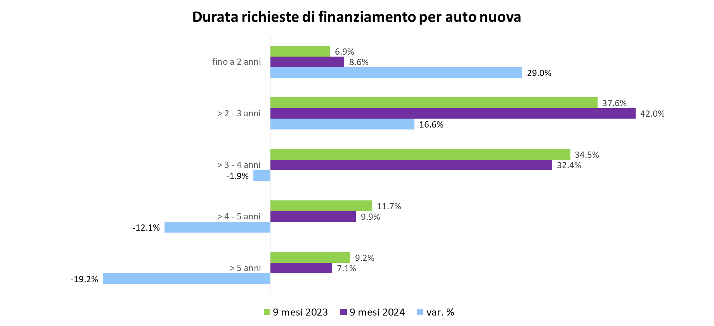
Osservatorio Credit & Mobility
Credito e Immatricolazioni
Mercato auto nuova, leasing e renting
Notes:
Text and graph slide [uses Title and Two Content layout]
The headline appears in Arial (Experian Dark Blue) at 34pt. If a subheadline is required, it should be manually sized to 20pt.
The text has five pre-set levels in 17pt Arial:
Level 1 – ranged to the left margin for continuous text; if you require a bold subheading you can embolden this to 17pt Arial Bold
Level 2 – ranged to the left text margin with a round bullet, subsequent lines aligning with the text of the previous line
Level 3 – horizontal dash bullet, subsequent lines aligning with the text of the previous line
Level 4 – round bullet, subsequent lines aligning with the text of the previous line
Level 5 –horizontal dash bullet, subsequent lines aligning with the text of the previous line
Advancing through the text levels can be done by using the ‘Increase List Level’ and ‘Decrease List Level’ buttons in the ‘Paragraph’ tools on the ‘Home’ ribbon.
If your text content exceeds the depth of the text box, you may need to consider creating an additional slide.
Working with graphs
The ‘Design’ ribbon in PowerPoint® shows a number of available graph options which are based on the colour theme of the template – always try to select a graph option and style which best communicates the data being presented. The graph ‘Design’ and ‘Format’ ribbons become available when the table has been selected, providing tools and controls directly within PowerPoint® which enable restyling and formatting of the graphic.
The brand mark on this slide layout is set up at the correct size and position and should not be altered. The date and footer info can be edited across all slides by using the ‘Header and Footer’ settings on the ‘Insert’ ribbon (do not edit these manually on the individual slides).

Slide 14
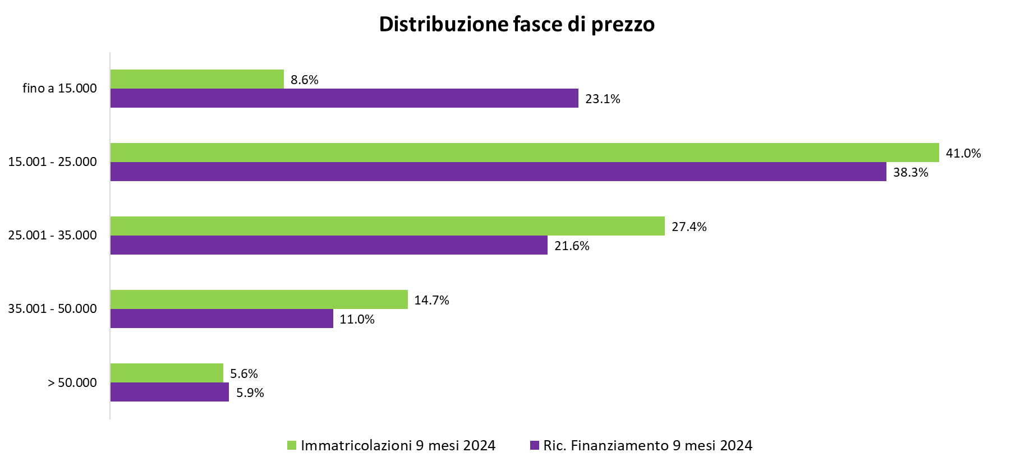
Osservatorio Credit & Mobility
Credito e Immatricolazioni
Mercato auto nuova, leasing e renting
Gli importi di finanziamento richiesti coprono una parte del valore dell’auto. Per le auto nuove:
Nel 2024 le fasce di prezzo immatricolate fino a 25.000€ sono il 49.6%, mentre le richieste fino alla stessa fascia di prezzo coprono il 61.4% dei volumi. Non tutto il valore dell’auto viene finanziato, considerando anticipo e maxi rata finale, quindi richieste di importi minori riguardano anche immatricolazioni di veicoli con fascia di prezzo più alto
Notes:
Text and graph slide [uses Title and Two Content layout]
The headline appears in Arial (Experian Dark Blue) at 34pt. If a subheadline is required, it should be manually sized to 20pt.
The text has five pre-set levels in 17pt Arial:
Level 1 – ranged to the left margin for continuous text; if you require a bold subheading you can embolden this to 17pt Arial Bold
Level 2 – ranged to the left text margin with a round bullet, subsequent lines aligning with the text of the previous line
Level 3 – horizontal dash bullet, subsequent lines aligning with the text of the previous line
Level 4 – round bullet, subsequent lines aligning with the text of the previous line
Level 5 –horizontal dash bullet, subsequent lines aligning with the text of the previous line
Advancing through the text levels can be done by using the ‘Increase List Level’ and ‘Decrease List Level’ buttons in the ‘Paragraph’ tools on the ‘Home’ ribbon.
If your text content exceeds the depth of the text box, you may need to consider creating an additional slide.
Working with graphs
The ‘Design’ ribbon in PowerPoint® shows a number of available graph options which are based on the colour theme of the template – always try to select a graph option and style which best communicates the data being presented. The graph ‘Design’ and ‘Format’ ribbons become available when the table has been selected, providing tools and controls directly within PowerPoint® which enable restyling and formatting of the graphic.
The brand mark on this slide layout is set up at the correct size and position and should not be altered. The date and footer info can be edited across all slides by using the ‘Header and Footer’ settings on the ‘Insert’ ribbon (do not edit these manually on the individual slides).

Slide 15
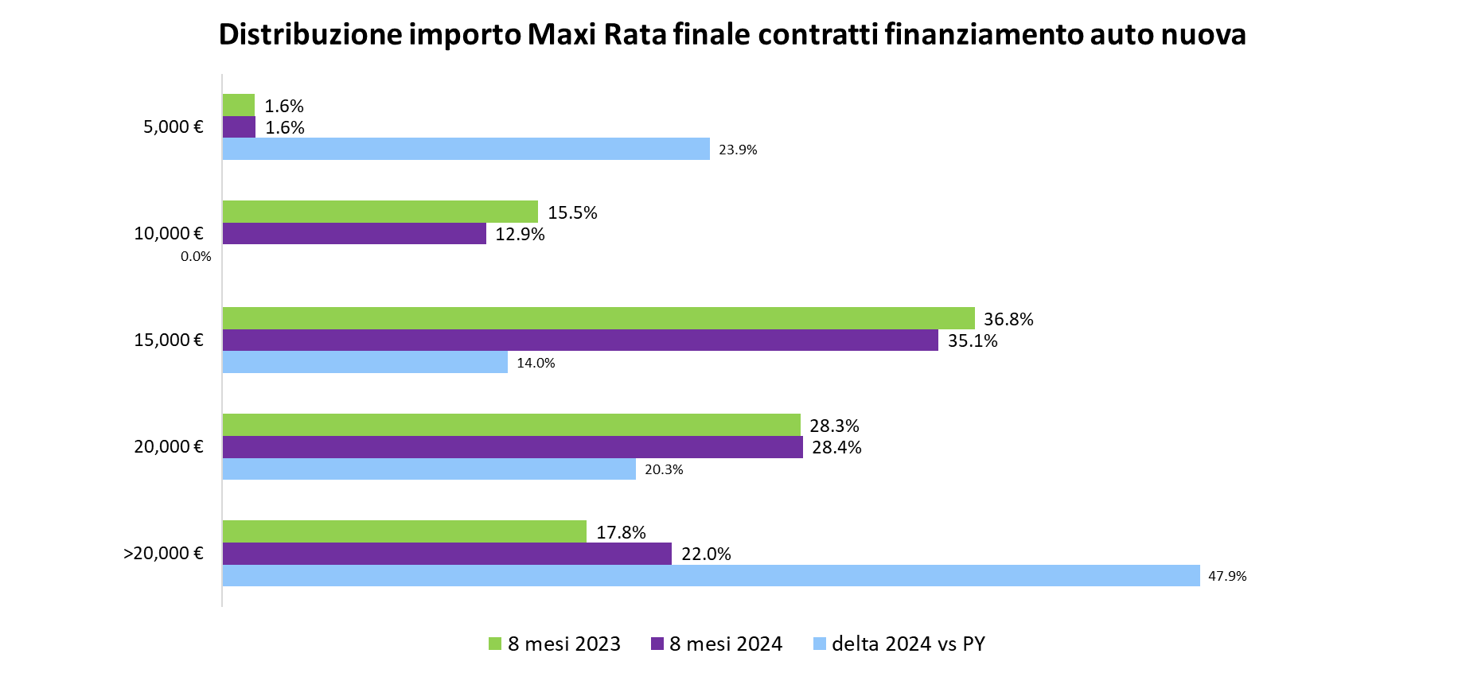
Osservatorio Credit & Mobility
Credito e Immatricolazioni
Mercato auto nuova, leasing e renting
Notes:
Text and graph slide [uses Title and Two Content layout]
The headline appears in Arial (Experian Dark Blue) at 34pt. If a subheadline is required, it should be manually sized to 20pt.
The text has five pre-set levels in 17pt Arial:
Level 1 – ranged to the left margin for continuous text; if you require a bold subheading you can embolden this to 17pt Arial Bold
Level 2 – ranged to the left text margin with a round bullet, subsequent lines aligning with the text of the previous line
Level 3 – horizontal dash bullet, subsequent lines aligning with the text of the previous line
Level 4 – round bullet, subsequent lines aligning with the text of the previous line
Level 5 –horizontal dash bullet, subsequent lines aligning with the text of the previous line
Advancing through the text levels can be done by using the ‘Increase List Level’ and ‘Decrease List Level’ buttons in the ‘Paragraph’ tools on the ‘Home’ ribbon.
If your text content exceeds the depth of the text box, you may need to consider creating an additional slide.
Working with graphs
The ‘Design’ ribbon in PowerPoint® shows a number of available graph options which are based on the colour theme of the template – always try to select a graph option and style which best communicates the data being presented. The graph ‘Design’ and ‘Format’ ribbons become available when the table has been selected, providing tools and controls directly within PowerPoint® which enable restyling and formatting of the graphic.
The brand mark on this slide layout is set up at the correct size and position and should not be altered. The date and footer info can be edited across all slides by using the ‘Header and Footer’ settings on the ‘Insert’ ribbon (do not edit these manually on the individual slides).

Slide 16
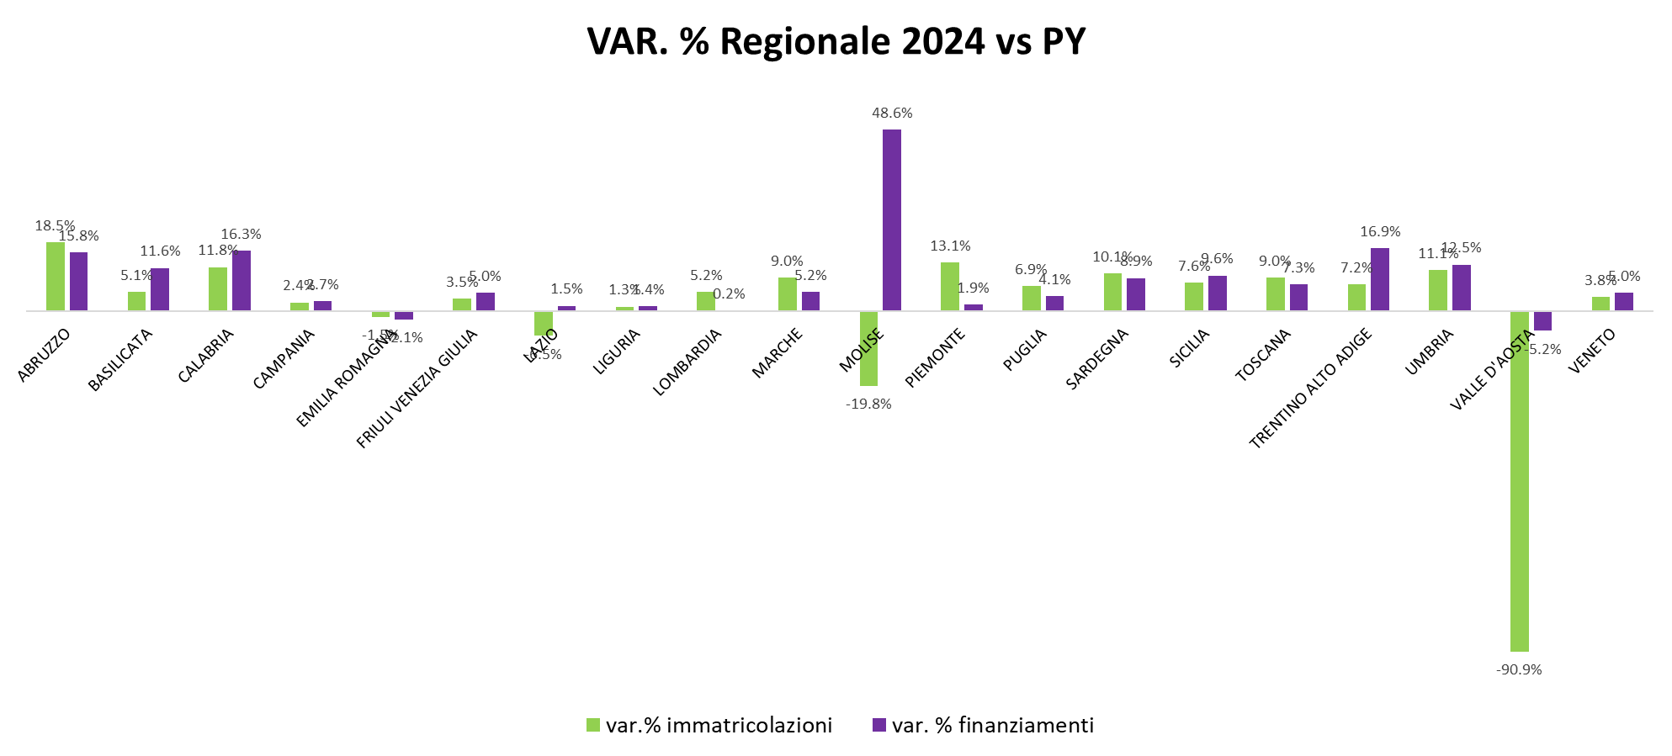
Osservatorio Credit & Mobility
Credito e Immatricolazioni
Mercato auto nuova, leasing e renting
Notes:
Text and graph slide [uses Title and Two Content layout]
The headline appears in Arial (Experian Dark Blue) at 34pt. If a subheadline is required, it should be manually sized to 20pt.
The text has five pre-set levels in 17pt Arial:
Level 1 – ranged to the left margin for continuous text; if you require a bold subheading you can embolden this to 17pt Arial Bold
Level 2 – ranged to the left text margin with a round bullet, subsequent lines aligning with the text of the previous line
Level 3 – horizontal dash bullet, subsequent lines aligning with the text of the previous line
Level 4 – round bullet, subsequent lines aligning with the text of the previous line
Level 5 –horizontal dash bullet, subsequent lines aligning with the text of the previous line
Advancing through the text levels can be done by using the ‘Increase List Level’ and ‘Decrease List Level’ buttons in the ‘Paragraph’ tools on the ‘Home’ ribbon.
If your text content exceeds the depth of the text box, you may need to consider creating an additional slide.
Working with graphs
The ‘Design’ ribbon in PowerPoint® shows a number of available graph options which are based on the colour theme of the template – always try to select a graph option and style which best communicates the data being presented. The graph ‘Design’ and ‘Format’ ribbons become available when the table has been selected, providing tools and controls directly within PowerPoint® which enable restyling and formatting of the graphic.
The brand mark on this slide layout is set up at the correct size and position and should not be altered. The date and footer info can be edited across all slides by using the ‘Header and Footer’ settings on the ‘Insert’ ribbon (do not edit these manually on the individual slides).

Slide 17
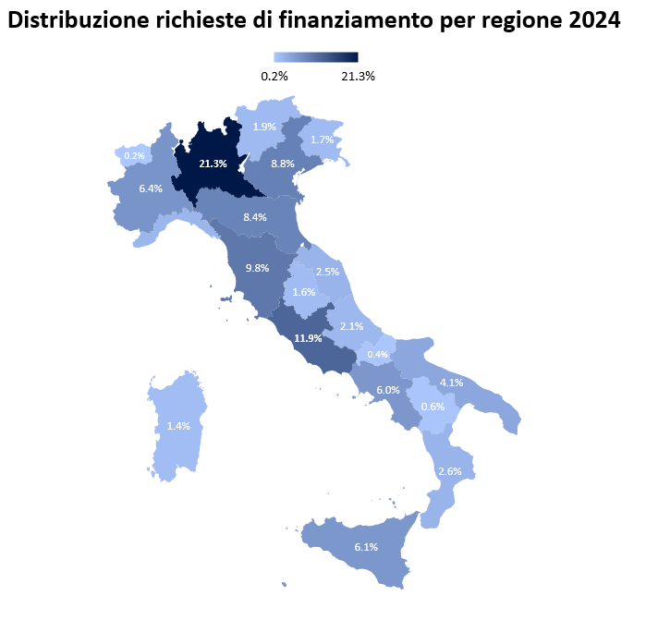
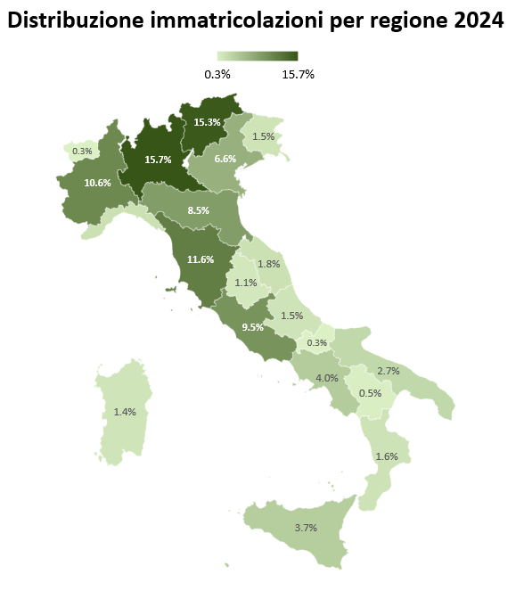
Osservatorio Credit & Mobility
Credito e Immatricolazioni
Mercato auto nuova, leasing e renting
Notes:
Text and graph slide [uses Title and Two Content layout]
The headline appears in Arial (Experian Dark Blue) at 34pt. If a subheadline is required, it should be manually sized to 20pt.
The text has five pre-set levels in 17pt Arial:
Level 1 – ranged to the left margin for continuous text; if you require a bold subheading you can embolden this to 17pt Arial Bold
Level 2 – ranged to the left text margin with a round bullet, subsequent lines aligning with the text of the previous line
Level 3 – horizontal dash bullet, subsequent lines aligning with the text of the previous line
Level 4 – round bullet, subsequent lines aligning with the text of the previous line
Level 5 –horizontal dash bullet, subsequent lines aligning with the text of the previous line
Advancing through the text levels can be done by using the ‘Increase List Level’ and ‘Decrease List Level’ buttons in the ‘Paragraph’ tools on the ‘Home’ ribbon.
If your text content exceeds the depth of the text box, you may need to consider creating an additional slide.
Working with graphs
The ‘Design’ ribbon in PowerPoint® shows a number of available graph options which are based on the colour theme of the template – always try to select a graph option and style which best communicates the data being presented. The graph ‘Design’ and ‘Format’ ribbons become available when the table has been selected, providing tools and controls directly within PowerPoint® which enable restyling and formatting of the graphic.
The brand mark on this slide layout is set up at the correct size and position and should not be altered. The date and footer info can be edited across all slides by using the ‘Header and Footer’ settings on the ‘Insert’ ribbon (do not edit these manually on the individual slides).

Slide 18
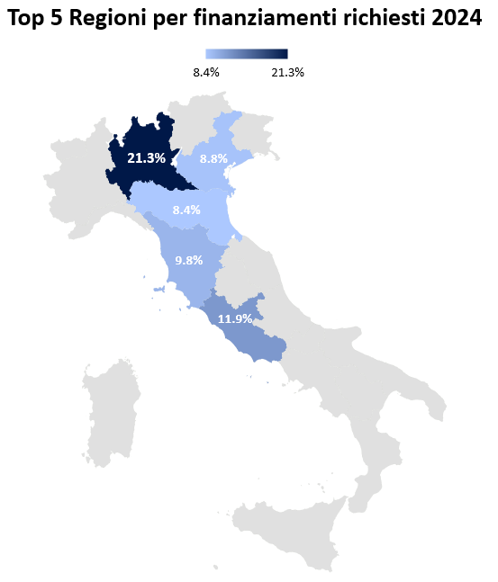
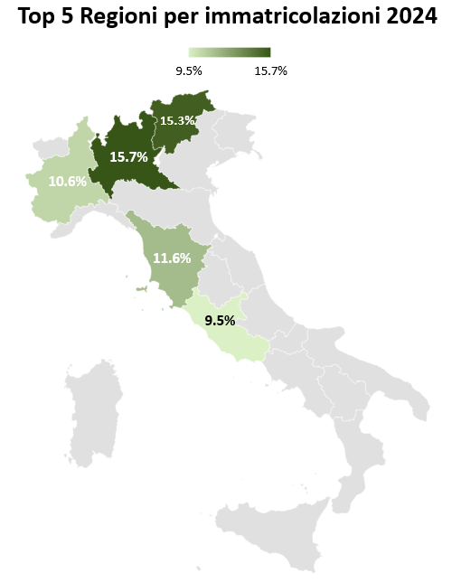
Osservatorio Credit & Mobility
Credito e Immatricolazioni
Mercato auto nuova, leasing e renting
Notes:
Text and graph slide [uses Title and Two Content layout]
The headline appears in Arial (Experian Dark Blue) at 34pt. If a subheadline is required, it should be manually sized to 20pt.
The text has five pre-set levels in 17pt Arial:
Level 1 – ranged to the left margin for continuous text; if you require a bold subheading you can embolden this to 17pt Arial Bold
Level 2 – ranged to the left text margin with a round bullet, subsequent lines aligning with the text of the previous line
Level 3 – horizontal dash bullet, subsequent lines aligning with the text of the previous line
Level 4 – round bullet, subsequent lines aligning with the text of the previous line
Level 5 –horizontal dash bullet, subsequent lines aligning with the text of the previous line
Advancing through the text levels can be done by using the ‘Increase List Level’ and ‘Decrease List Level’ buttons in the ‘Paragraph’ tools on the ‘Home’ ribbon.
If your text content exceeds the depth of the text box, you may need to consider creating an additional slide.
Working with graphs
The ‘Design’ ribbon in PowerPoint® shows a number of available graph options which are based on the colour theme of the template – always try to select a graph option and style which best communicates the data being presented. The graph ‘Design’ and ‘Format’ ribbons become available when the table has been selected, providing tools and controls directly within PowerPoint® which enable restyling and formatting of the graphic.
The brand mark on this slide layout is set up at the correct size and position and should not be altered. The date and footer info can be edited across all slides by using the ‘Header and Footer’ settings on the ‘Insert’ ribbon (do not edit these manually on the individual slides).

Slide 19
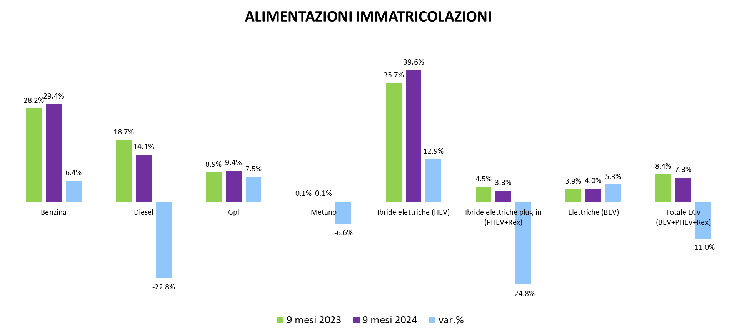
Osservatorio Credit & Mobility
Credito e Immatricolazioni
Mercato auto nuova, leasing e renting
Notes:
Text and graph slide [uses Title and Two Content layout]
The headline appears in Arial (Experian Dark Blue) at 34pt. If a subheadline is required, it should be manually sized to 20pt.
The text has five pre-set levels in 17pt Arial:
Level 1 – ranged to the left margin for continuous text; if you require a bold subheading you can embolden this to 17pt Arial Bold
Level 2 – ranged to the left text margin with a round bullet, subsequent lines aligning with the text of the previous line
Level 3 – horizontal dash bullet, subsequent lines aligning with the text of the previous line
Level 4 – round bullet, subsequent lines aligning with the text of the previous line
Level 5 –horizontal dash bullet, subsequent lines aligning with the text of the previous line
Advancing through the text levels can be done by using the ‘Increase List Level’ and ‘Decrease List Level’ buttons in the ‘Paragraph’ tools on the ‘Home’ ribbon.
If your text content exceeds the depth of the text box, you may need to consider creating an additional slide.
Working with graphs
The ‘Design’ ribbon in PowerPoint® shows a number of available graph options which are based on the colour theme of the template – always try to select a graph option and style which best communicates the data being presented. The graph ‘Design’ and ‘Format’ ribbons become available when the table has been selected, providing tools and controls directly within PowerPoint® which enable restyling and formatting of the graphic.
The brand mark on this slide layout is set up at the correct size and position and should not be altered. The date and footer info can be edited across all slides by using the ‘Header and Footer’ settings on the ‘Insert’ ribbon (do not edit these manually on the individual slides).

Slide 20
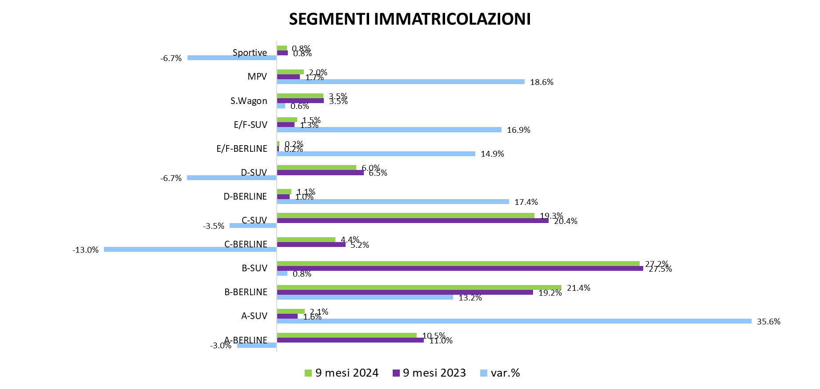
Osservatorio Credit & Mobility
Credito e Immatricolazioni
Mercato auto nuova, leasing e renting
Notes:
Text and graph slide [uses Title and Two Content layout]
The headline appears in Arial (Experian Dark Blue) at 34pt. If a subheadline is required, it should be manually sized to 20pt.
The text has five pre-set levels in 17pt Arial:
Level 1 – ranged to the left margin for continuous text; if you require a bold subheading you can embolden this to 17pt Arial Bold
Level 2 – ranged to the left text margin with a round bullet, subsequent lines aligning with the text of the previous line
Level 3 – horizontal dash bullet, subsequent lines aligning with the text of the previous line
Level 4 – round bullet, subsequent lines aligning with the text of the previous line
Level 5 –horizontal dash bullet, subsequent lines aligning with the text of the previous line
Advancing through the text levels can be done by using the ‘Increase List Level’ and ‘Decrease List Level’ buttons in the ‘Paragraph’ tools on the ‘Home’ ribbon.
If your text content exceeds the depth of the text box, you may need to consider creating an additional slide.
Working with graphs
The ‘Design’ ribbon in PowerPoint® shows a number of available graph options which are based on the colour theme of the template – always try to select a graph option and style which best communicates the data being presented. The graph ‘Design’ and ‘Format’ ribbons become available when the table has been selected, providing tools and controls directly within PowerPoint® which enable restyling and formatting of the graphic.
The brand mark on this slide layout is set up at the correct size and position and should not be altered. The date and footer info can be edited across all slides by using the ‘Header and Footer’ settings on the ‘Insert’ ribbon (do not edit these manually on the individual slides).

Slide 21
Mercato auto usata
Trasferimenti di proprietà e richieste di finanziamento
Notes:
The notes that accompany these example slides form a guideline to producing successful presentations and working effectively with the template. A number of slide layout masters have been created to allow switching between different slide styles; by ‘right-clicking’ a slide you can ‘apply’ a different slide layout (the content of which needs to be applicable to the layout you are choosing).
Printing your presentation in ‘black and white’ will avoid overuse of colour toners – you can preview the ‘black and white’ appearance by choosing the option under the ‘View’ tab in PowerPoint®.
General principles
Guides have been added to assist with the correct placement of all presentation elements (text and graphics) – please work within the slide margins and use the guides wherever possible. By following the example slides you will see how elements are positioned. Text should not be resized or distorted to fit; if your content won’t fit on a single slide, use an additional slide instead. Remember… slides should be a prompt for the presenter and not filled with copy for reading out in full.
Opening slide [uses Holding Slide layout]
This slide is intended as an introductory ‘opening’ slide and should not include any additional text or graphics. The same slide layout is used as a presentation closing slide. The brand mark and data art graphic on this slide layout are set up at the correct size and position and should not be altered.

Slide 22
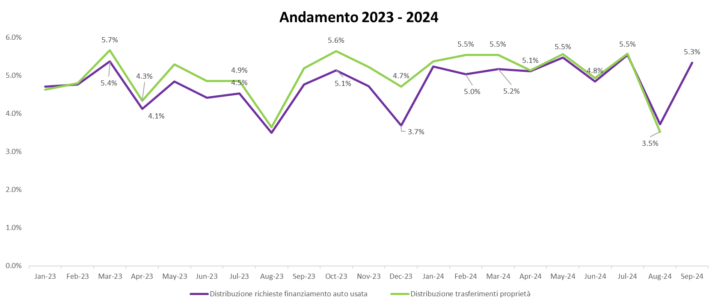
Osservatorio Credit & Mobility
Credito e Trasferimenti di proprietà
Mercato auto usata
Non è presente un legame diretto tra immatricolazioni e richieste di finanziamento dello stesso mese
Notes:
Text and graph slide [uses Title and Two Content layout]
The headline appears in Arial (Experian Dark Blue) at 34pt. If a subheadline is required, it should be manually sized to 20pt.
The text has five pre-set levels in 17pt Arial:
Level 1 – ranged to the left margin for continuous text; if you require a bold subheading you can embolden this to 17pt Arial Bold
Level 2 – ranged to the left text margin with a round bullet, subsequent lines aligning with the text of the previous line
Level 3 – horizontal dash bullet, subsequent lines aligning with the text of the previous line
Level 4 – round bullet, subsequent lines aligning with the text of the previous line
Level 5 –horizontal dash bullet, subsequent lines aligning with the text of the previous line
Advancing through the text levels can be done by using the ‘Increase List Level’ and ‘Decrease List Level’ buttons in the ‘Paragraph’ tools on the ‘Home’ ribbon.
If your text content exceeds the depth of the text box, you may need to consider creating an additional slide.
Working with graphs
The ‘Design’ ribbon in PowerPoint® shows a number of available graph options which are based on the colour theme of the template – always try to select a graph option and style which best communicates the data being presented. The graph ‘Design’ and ‘Format’ ribbons become available when the table has been selected, providing tools and controls directly within PowerPoint® which enable restyling and formatting of the graphic.
The brand mark on this slide layout is set up at the correct size and position and should not be altered. The date and footer info can be edited across all slides by using the ‘Header and Footer’ settings on the ‘Insert’ ribbon (do not edit these manually on the individual slides).

Slide 23
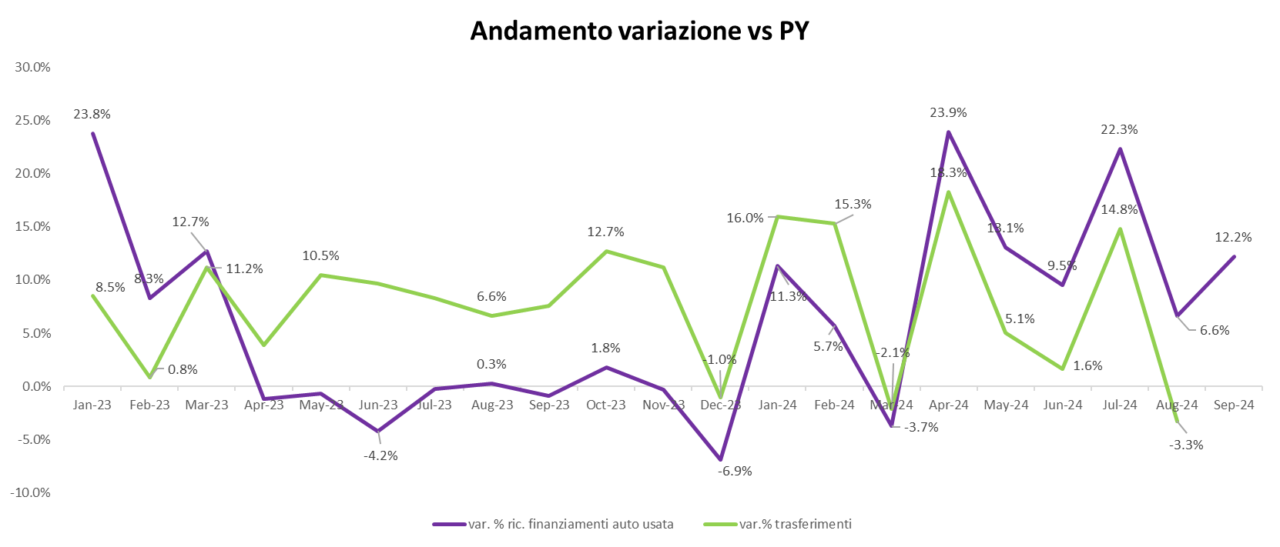
Osservatorio Credit & Mobility
Credito e Trasferimenti di proprietà
Mercato auto usata
Non è presente un legame diretto tra immatricolazioni e richieste di finanziamento dello stesso mese
Notes:
Text and graph slide [uses Title and Two Content layout]
The headline appears in Arial (Experian Dark Blue) at 34pt. If a subheadline is required, it should be manually sized to 20pt.
The text has five pre-set levels in 17pt Arial:
Level 1 – ranged to the left margin for continuous text; if you require a bold subheading you can embolden this to 17pt Arial Bold
Level 2 – ranged to the left text margin with a round bullet, subsequent lines aligning with the text of the previous line
Level 3 – horizontal dash bullet, subsequent lines aligning with the text of the previous line
Level 4 – round bullet, subsequent lines aligning with the text of the previous line
Level 5 –horizontal dash bullet, subsequent lines aligning with the text of the previous line
Advancing through the text levels can be done by using the ‘Increase List Level’ and ‘Decrease List Level’ buttons in the ‘Paragraph’ tools on the ‘Home’ ribbon.
If your text content exceeds the depth of the text box, you may need to consider creating an additional slide.
Working with graphs
The ‘Design’ ribbon in PowerPoint® shows a number of available graph options which are based on the colour theme of the template – always try to select a graph option and style which best communicates the data being presented. The graph ‘Design’ and ‘Format’ ribbons become available when the table has been selected, providing tools and controls directly within PowerPoint® which enable restyling and formatting of the graphic.
The brand mark on this slide layout is set up at the correct size and position and should not be altered. The date and footer info can be edited across all slides by using the ‘Header and Footer’ settings on the ‘Insert’ ribbon (do not edit these manually on the individual slides).

Slide 24
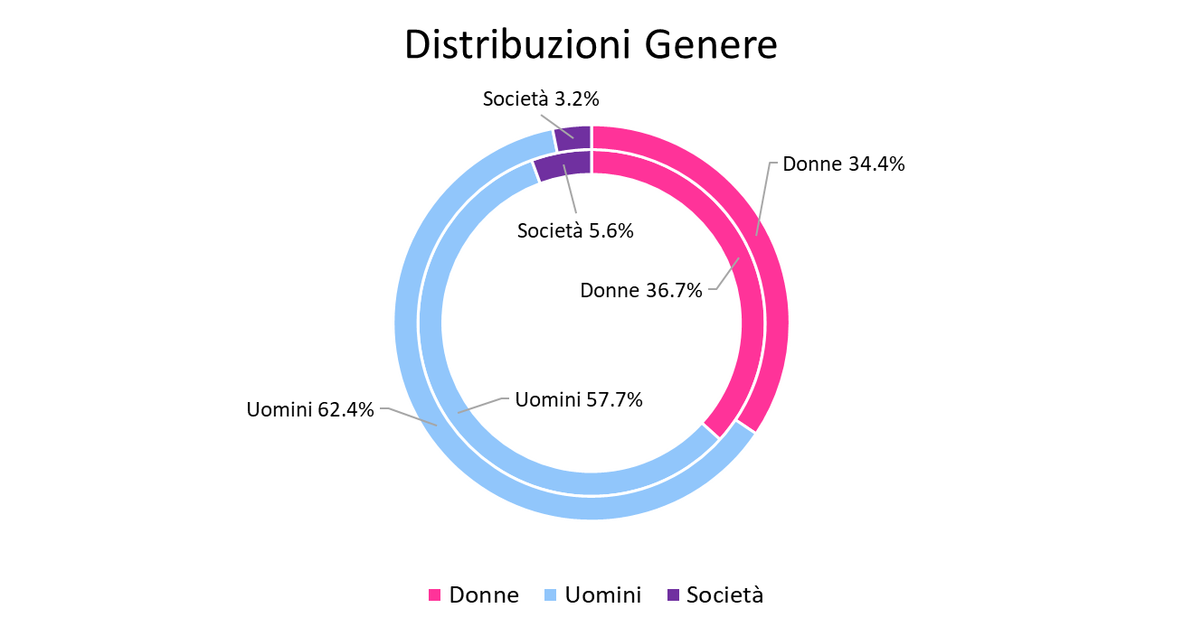
Osservatorio Credit & Mobility
Credito e Trasferimenti di proprietà
Mercato auto usata
Anello esterno: Richieste di finanziamento
Anello interno: Immatricolazioni
- 9 Mesi 2024
Notes:
Text and graph slide [uses Title and Two Content layout]
The headline appears in Arial (Experian Dark Blue) at 34pt. If a subheadline is required, it should be manually sized to 20pt.
The text has five pre-set levels in 17pt Arial:
Level 1 – ranged to the left margin for continuous text; if you require a bold subheading you can embolden this to 17pt Arial Bold
Level 2 – ranged to the left text margin with a round bullet, subsequent lines aligning with the text of the previous line
Level 3 – horizontal dash bullet, subsequent lines aligning with the text of the previous line
Level 4 – round bullet, subsequent lines aligning with the text of the previous line
Level 5 –horizontal dash bullet, subsequent lines aligning with the text of the previous line
Advancing through the text levels can be done by using the ‘Increase List Level’ and ‘Decrease List Level’ buttons in the ‘Paragraph’ tools on the ‘Home’ ribbon.
If your text content exceeds the depth of the text box, you may need to consider creating an additional slide.
Working with graphs
The ‘Design’ ribbon in PowerPoint® shows a number of available graph options which are based on the colour theme of the template – always try to select a graph option and style which best communicates the data being presented. The graph ‘Design’ and ‘Format’ ribbons become available when the table has been selected, providing tools and controls directly within PowerPoint® which enable restyling and formatting of the graphic.
The brand mark on this slide layout is set up at the correct size and position and should not be altered. The date and footer info can be edited across all slides by using the ‘Header and Footer’ settings on the ‘Insert’ ribbon (do not edit these manually on the individual slides).

Slide 25
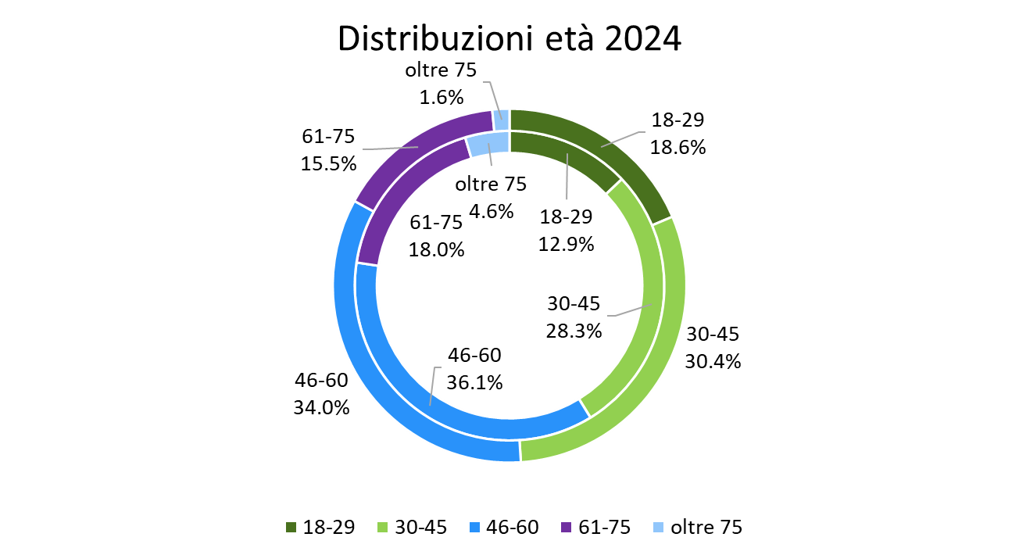
Osservatorio Credit & Mobility
Credito e Trasferimenti di proprietà
Mercato auto usata
Anello esterno: Richieste di finanziamento
Anello interno: Immatricolazioni
- 9 Mesi 2024
Notes:
Text and graph slide [uses Title and Two Content layout]
The headline appears in Arial (Experian Dark Blue) at 34pt. If a subheadline is required, it should be manually sized to 20pt.
The text has five pre-set levels in 17pt Arial:
Level 1 – ranged to the left margin for continuous text; if you require a bold subheading you can embolden this to 17pt Arial Bold
Level 2 – ranged to the left text margin with a round bullet, subsequent lines aligning with the text of the previous line
Level 3 – horizontal dash bullet, subsequent lines aligning with the text of the previous line
Level 4 – round bullet, subsequent lines aligning with the text of the previous line
Level 5 –horizontal dash bullet, subsequent lines aligning with the text of the previous line
Advancing through the text levels can be done by using the ‘Increase List Level’ and ‘Decrease List Level’ buttons in the ‘Paragraph’ tools on the ‘Home’ ribbon.
If your text content exceeds the depth of the text box, you may need to consider creating an additional slide.
Working with graphs
The ‘Design’ ribbon in PowerPoint® shows a number of available graph options which are based on the colour theme of the template – always try to select a graph option and style which best communicates the data being presented. The graph ‘Design’ and ‘Format’ ribbons become available when the table has been selected, providing tools and controls directly within PowerPoint® which enable restyling and formatting of the graphic.
The brand mark on this slide layout is set up at the correct size and position and should not be altered. The date and footer info can be edited across all slides by using the ‘Header and Footer’ settings on the ‘Insert’ ribbon (do not edit these manually on the individual slides).

Slide 26
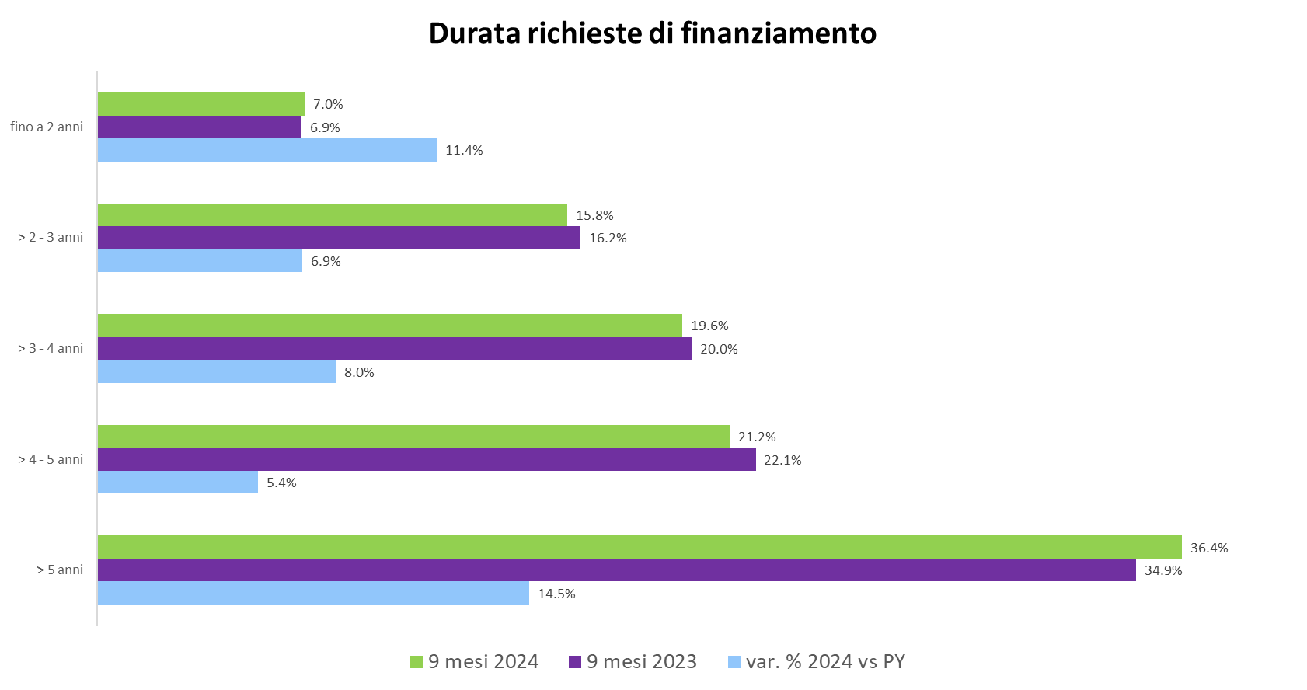
Osservatorio Credit & Mobility
Credito e Trasferimenti di proprietà
Mercato auto usata
Notes:
Text and graph slide [uses Title and Two Content layout]
The headline appears in Arial (Experian Dark Blue) at 34pt. If a subheadline is required, it should be manually sized to 20pt.
The text has five pre-set levels in 17pt Arial:
Level 1 – ranged to the left margin for continuous text; if you require a bold subheading you can embolden this to 17pt Arial Bold
Level 2 – ranged to the left text margin with a round bullet, subsequent lines aligning with the text of the previous line
Level 3 – horizontal dash bullet, subsequent lines aligning with the text of the previous line
Level 4 – round bullet, subsequent lines aligning with the text of the previous line
Level 5 –horizontal dash bullet, subsequent lines aligning with the text of the previous line
Advancing through the text levels can be done by using the ‘Increase List Level’ and ‘Decrease List Level’ buttons in the ‘Paragraph’ tools on the ‘Home’ ribbon.
If your text content exceeds the depth of the text box, you may need to consider creating an additional slide.
Working with graphs
The ‘Design’ ribbon in PowerPoint® shows a number of available graph options which are based on the colour theme of the template – always try to select a graph option and style which best communicates the data being presented. The graph ‘Design’ and ‘Format’ ribbons become available when the table has been selected, providing tools and controls directly within PowerPoint® which enable restyling and formatting of the graphic.
The brand mark on this slide layout is set up at the correct size and position and should not be altered. The date and footer info can be edited across all slides by using the ‘Header and Footer’ settings on the ‘Insert’ ribbon (do not edit these manually on the individual slides).

Slide 27
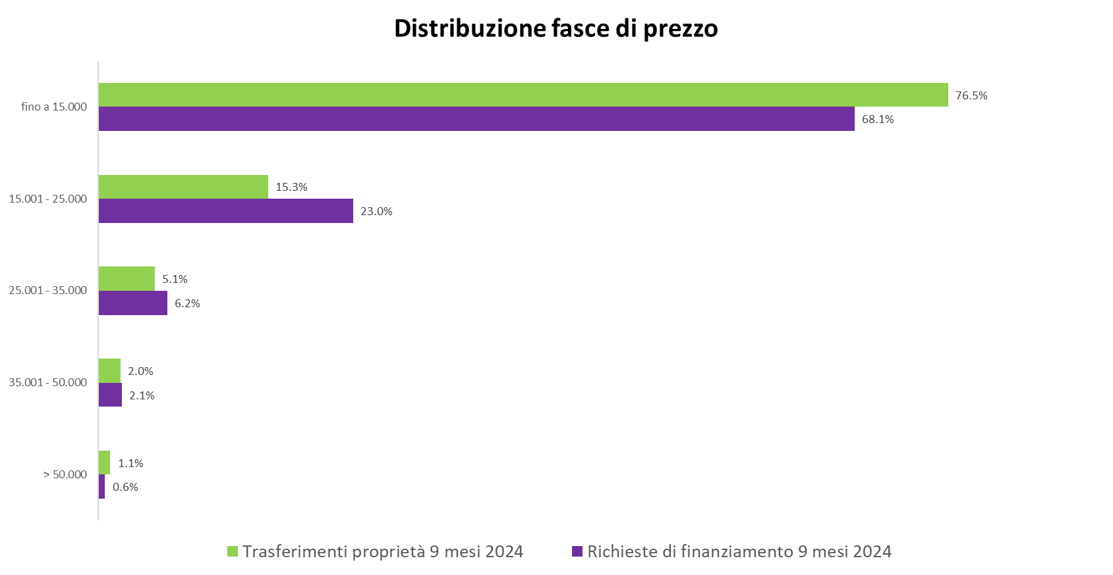
Osservatorio Credit & Mobility
Credito e Trasferimenti di proprietà
Mercato auto usata
Notes:
Text and graph slide [uses Title and Two Content layout]
The headline appears in Arial (Experian Dark Blue) at 34pt. If a subheadline is required, it should be manually sized to 20pt.
The text has five pre-set levels in 17pt Arial:
Level 1 – ranged to the left margin for continuous text; if you require a bold subheading you can embolden this to 17pt Arial Bold
Level 2 – ranged to the left text margin with a round bullet, subsequent lines aligning with the text of the previous line
Level 3 – horizontal dash bullet, subsequent lines aligning with the text of the previous line
Level 4 – round bullet, subsequent lines aligning with the text of the previous line
Level 5 –horizontal dash bullet, subsequent lines aligning with the text of the previous line
Advancing through the text levels can be done by using the ‘Increase List Level’ and ‘Decrease List Level’ buttons in the ‘Paragraph’ tools on the ‘Home’ ribbon.
If your text content exceeds the depth of the text box, you may need to consider creating an additional slide.
Working with graphs
The ‘Design’ ribbon in PowerPoint® shows a number of available graph options which are based on the colour theme of the template – always try to select a graph option and style which best communicates the data being presented. The graph ‘Design’ and ‘Format’ ribbons become available when the table has been selected, providing tools and controls directly within PowerPoint® which enable restyling and formatting of the graphic.
The brand mark on this slide layout is set up at the correct size and position and should not be altered. The date and footer info can be edited across all slides by using the ‘Header and Footer’ settings on the ‘Insert’ ribbon (do not edit these manually on the individual slides).

Slide 28
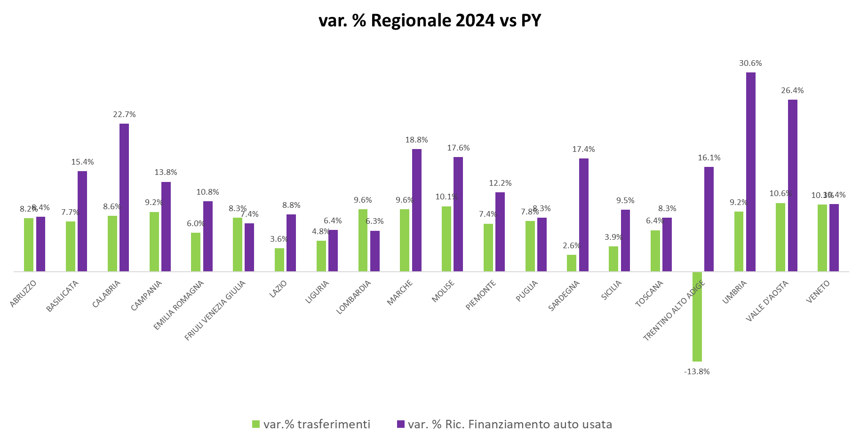
Osservatorio Credit & Mobility
Credito e Trasferimenti di proprietà
Mercato auto usata
Notes:
Text and graph slide [uses Title and Two Content layout]
The headline appears in Arial (Experian Dark Blue) at 34pt. If a subheadline is required, it should be manually sized to 20pt.
The text has five pre-set levels in 17pt Arial:
Level 1 – ranged to the left margin for continuous text; if you require a bold subheading you can embolden this to 17pt Arial Bold
Level 2 – ranged to the left text margin with a round bullet, subsequent lines aligning with the text of the previous line
Level 3 – horizontal dash bullet, subsequent lines aligning with the text of the previous line
Level 4 – round bullet, subsequent lines aligning with the text of the previous line
Level 5 –horizontal dash bullet, subsequent lines aligning with the text of the previous line
Advancing through the text levels can be done by using the ‘Increase List Level’ and ‘Decrease List Level’ buttons in the ‘Paragraph’ tools on the ‘Home’ ribbon.
If your text content exceeds the depth of the text box, you may need to consider creating an additional slide.
Working with graphs
The ‘Design’ ribbon in PowerPoint® shows a number of available graph options which are based on the colour theme of the template – always try to select a graph option and style which best communicates the data being presented. The graph ‘Design’ and ‘Format’ ribbons become available when the table has been selected, providing tools and controls directly within PowerPoint® which enable restyling and formatting of the graphic.
The brand mark on this slide layout is set up at the correct size and position and should not be altered. The date and footer info can be edited across all slides by using the ‘Header and Footer’ settings on the ‘Insert’ ribbon (do not edit these manually on the individual slides).

Slide 29
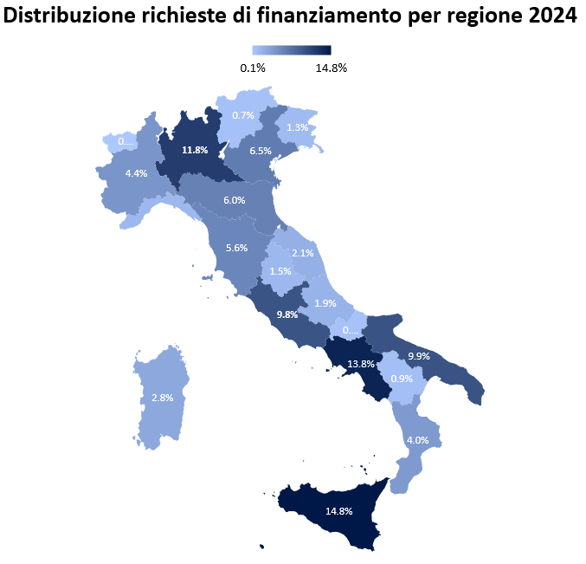
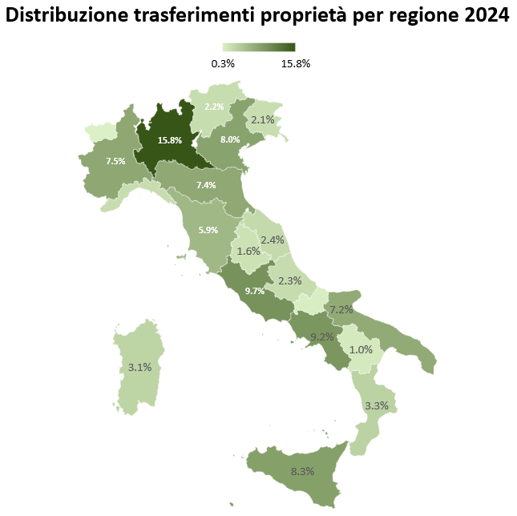
Osservatorio Credit & Mobility
Credito e Trasferimenti di proprietà
Mercato auto usata
Notes:
Text and graph slide [uses Title and Two Content layout]
The headline appears in Arial (Experian Dark Blue) at 34pt. If a subheadline is required, it should be manually sized to 20pt.
The text has five pre-set levels in 17pt Arial:
Level 1 – ranged to the left margin for continuous text; if you require a bold subheading you can embolden this to 17pt Arial Bold
Level 2 – ranged to the left text margin with a round bullet, subsequent lines aligning with the text of the previous line
Level 3 – horizontal dash bullet, subsequent lines aligning with the text of the previous line
Level 4 – round bullet, subsequent lines aligning with the text of the previous line
Level 5 –horizontal dash bullet, subsequent lines aligning with the text of the previous line
Advancing through the text levels can be done by using the ‘Increase List Level’ and ‘Decrease List Level’ buttons in the ‘Paragraph’ tools on the ‘Home’ ribbon.
If your text content exceeds the depth of the text box, you may need to consider creating an additional slide.
Working with graphs
The ‘Design’ ribbon in PowerPoint® shows a number of available graph options which are based on the colour theme of the template – always try to select a graph option and style which best communicates the data being presented. The graph ‘Design’ and ‘Format’ ribbons become available when the table has been selected, providing tools and controls directly within PowerPoint® which enable restyling and formatting of the graphic.
The brand mark on this slide layout is set up at the correct size and position and should not be altered. The date and footer info can be edited across all slides by using the ‘Header and Footer’ settings on the ‘Insert’ ribbon (do not edit these manually on the individual slides).

Slide 30
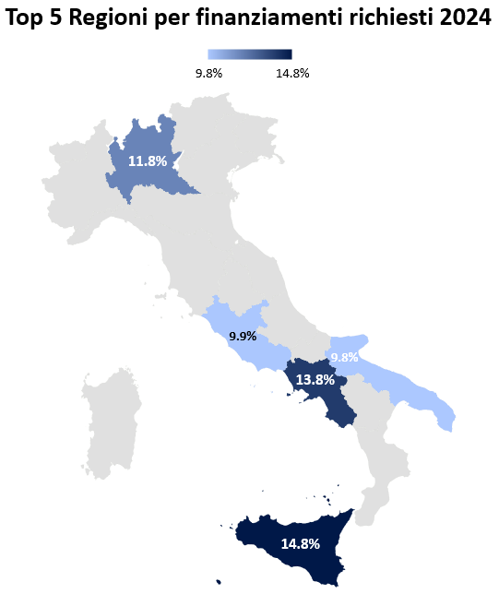
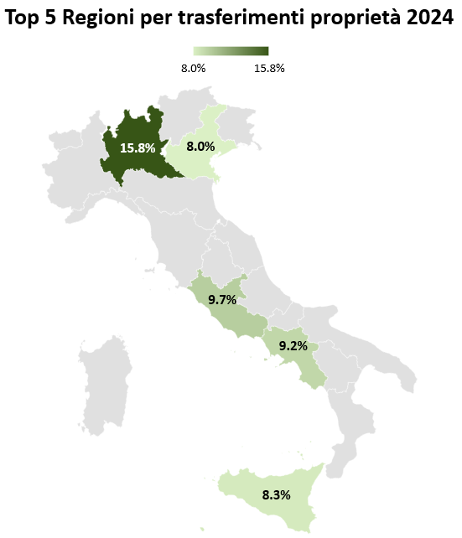
Osservatorio Credit & Mobility
Credito e Trasferimenti di proprietà
Mercato auto usata
Notes:
Text and graph slide [uses Title and Two Content layout]
The headline appears in Arial (Experian Dark Blue) at 34pt. If a subheadline is required, it should be manually sized to 20pt.
The text has five pre-set levels in 17pt Arial:
Level 1 – ranged to the left margin for continuous text; if you require a bold subheading you can embolden this to 17pt Arial Bold
Level 2 – ranged to the left text margin with a round bullet, subsequent lines aligning with the text of the previous line
Level 3 – horizontal dash bullet, subsequent lines aligning with the text of the previous line
Level 4 – round bullet, subsequent lines aligning with the text of the previous line
Level 5 –horizontal dash bullet, subsequent lines aligning with the text of the previous line
Advancing through the text levels can be done by using the ‘Increase List Level’ and ‘Decrease List Level’ buttons in the ‘Paragraph’ tools on the ‘Home’ ribbon.
If your text content exceeds the depth of the text box, you may need to consider creating an additional slide.
Working with graphs
The ‘Design’ ribbon in PowerPoint® shows a number of available graph options which are based on the colour theme of the template – always try to select a graph option and style which best communicates the data being presented. The graph ‘Design’ and ‘Format’ ribbons become available when the table has been selected, providing tools and controls directly within PowerPoint® which enable restyling and formatting of the graphic.
The brand mark on this slide layout is set up at the correct size and position and should not be altered. The date and footer info can be edited across all slides by using the ‘Header and Footer’ settings on the ‘Insert’ ribbon (do not edit these manually on the individual slides).

Slide 31
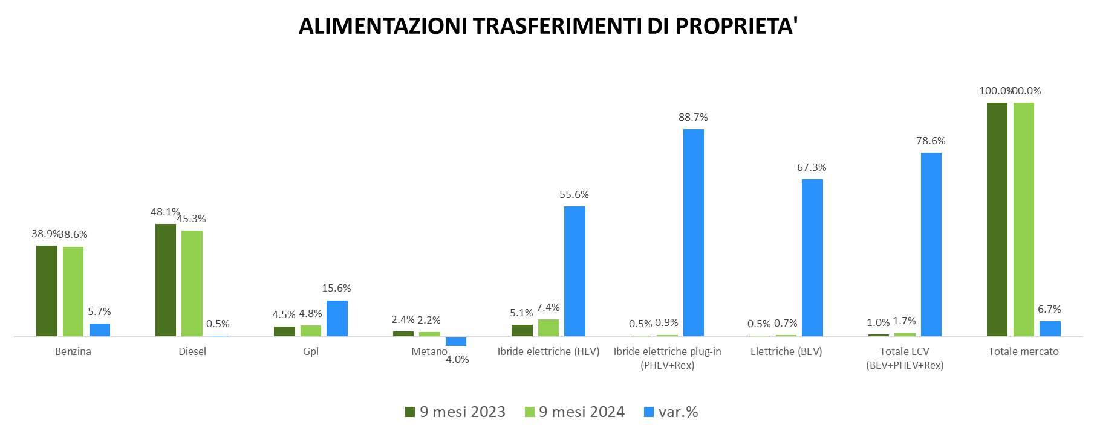
Osservatorio Credit & Mobility
Credito e Trasferimenti di proprietà
Mercato auto usata
Notes:
Text and graph slide [uses Title and Two Content layout]
The headline appears in Arial (Experian Dark Blue) at 34pt. If a subheadline is required, it should be manually sized to 20pt.
The text has five pre-set levels in 17pt Arial:
Level 1 – ranged to the left margin for continuous text; if you require a bold subheading you can embolden this to 17pt Arial Bold
Level 2 – ranged to the left text margin with a round bullet, subsequent lines aligning with the text of the previous line
Level 3 – horizontal dash bullet, subsequent lines aligning with the text of the previous line
Level 4 – round bullet, subsequent lines aligning with the text of the previous line
Level 5 –horizontal dash bullet, subsequent lines aligning with the text of the previous line
Advancing through the text levels can be done by using the ‘Increase List Level’ and ‘Decrease List Level’ buttons in the ‘Paragraph’ tools on the ‘Home’ ribbon.
If your text content exceeds the depth of the text box, you may need to consider creating an additional slide.
Working with graphs
The ‘Design’ ribbon in PowerPoint® shows a number of available graph options which are based on the colour theme of the template – always try to select a graph option and style which best communicates the data being presented. The graph ‘Design’ and ‘Format’ ribbons become available when the table has been selected, providing tools and controls directly within PowerPoint® which enable restyling and formatting of the graphic.
The brand mark on this slide layout is set up at the correct size and position and should not be altered. The date and footer info can be edited across all slides by using the ‘Header and Footer’ settings on the ‘Insert’ ribbon (do not edit these manually on the individual slides).

Slide 32
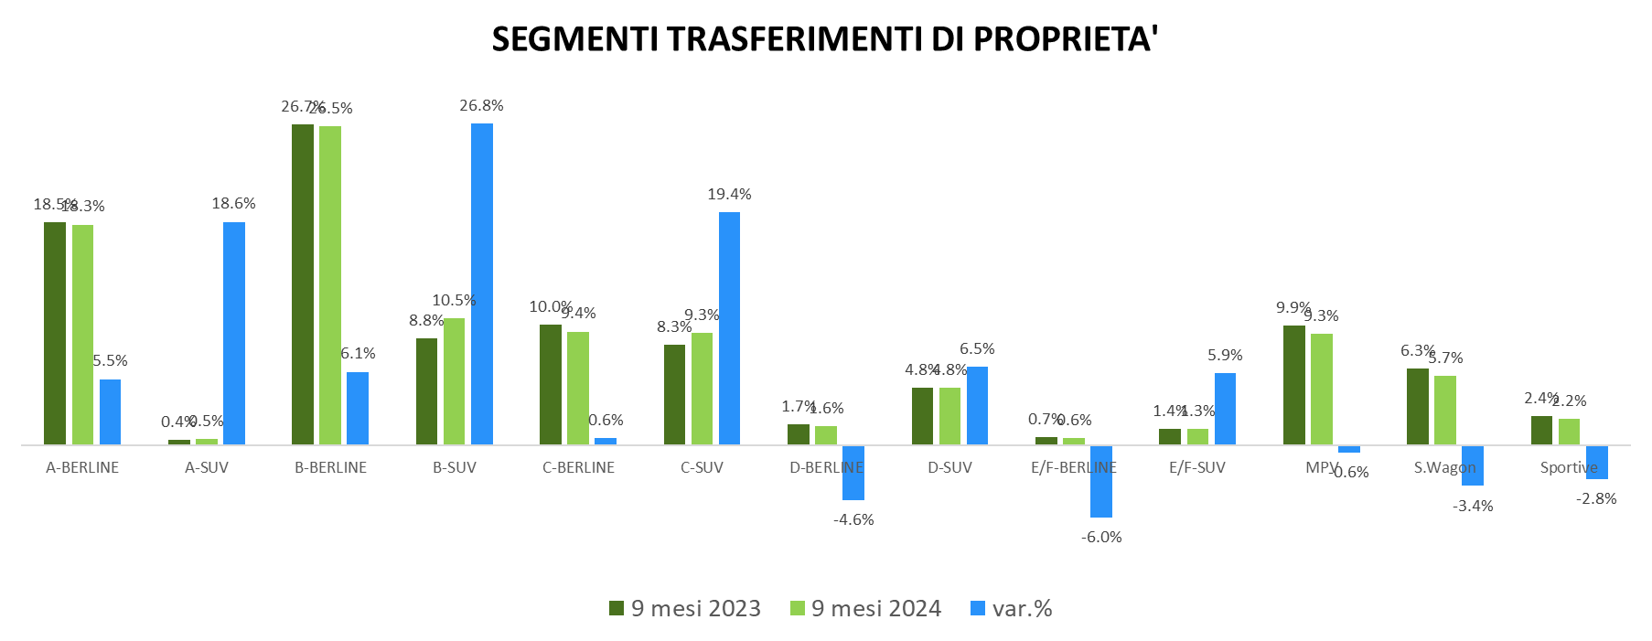
Osservatorio Credit & Mobility
Credito e Trasferimenti di proprietà
Mercato auto usata
Notes:
Text and graph slide [uses Title and Two Content layout]
The headline appears in Arial (Experian Dark Blue) at 34pt. If a subheadline is required, it should be manually sized to 20pt.
The text has five pre-set levels in 17pt Arial:
Level 1 – ranged to the left margin for continuous text; if you require a bold subheading you can embolden this to 17pt Arial Bold
Level 2 – ranged to the left text margin with a round bullet, subsequent lines aligning with the text of the previous line
Level 3 – horizontal dash bullet, subsequent lines aligning with the text of the previous line
Level 4 – round bullet, subsequent lines aligning with the text of the previous line
Level 5 –horizontal dash bullet, subsequent lines aligning with the text of the previous line
Advancing through the text levels can be done by using the ‘Increase List Level’ and ‘Decrease List Level’ buttons in the ‘Paragraph’ tools on the ‘Home’ ribbon.
If your text content exceeds the depth of the text box, you may need to consider creating an additional slide.
Working with graphs
The ‘Design’ ribbon in PowerPoint® shows a number of available graph options which are based on the colour theme of the template – always try to select a graph option and style which best communicates the data being presented. The graph ‘Design’ and ‘Format’ ribbons become available when the table has been selected, providing tools and controls directly within PowerPoint® which enable restyling and formatting of the graphic.
The brand mark on this slide layout is set up at the correct size and position and should not be altered. The date and footer info can be edited across all slides by using the ‘Header and Footer’ settings on the ‘Insert’ ribbon (do not edit these manually on the individual slides).

Slide 33
Mercato veicoli commerciali
Immatricolazioni, trasferimenti di proprietà e richieste di finanziamento
Notes:
The notes that accompany these example slides form a guideline to producing successful presentations and working effectively with the template. A number of slide layout masters have been created to allow switching between different slide styles; by ‘right-clicking’ a slide you can ‘apply’ a different slide layout (the content of which needs to be applicable to the layout you are choosing).
Printing your presentation in ‘black and white’ will avoid overuse of colour toners – you can preview the ‘black and white’ appearance by choosing the option under the ‘View’ tab in PowerPoint®.
General principles
Guides have been added to assist with the correct placement of all presentation elements (text and graphics) – please work within the slide margins and use the guides wherever possible. By following the example slides you will see how elements are positioned. Text should not be resized or distorted to fit; if your content won’t fit on a single slide, use an additional slide instead. Remember… slides should be a prompt for the presenter and not filled with copy for reading out in full.
Opening slide [uses Holding Slide layout]
This slide is intended as an introductory ‘opening’ slide and should not include any additional text or graphics. The same slide layout is used as a presentation closing slide. The brand mark and data art graphic on this slide layout are set up at the correct size and position and should not be altered.

Slide 34
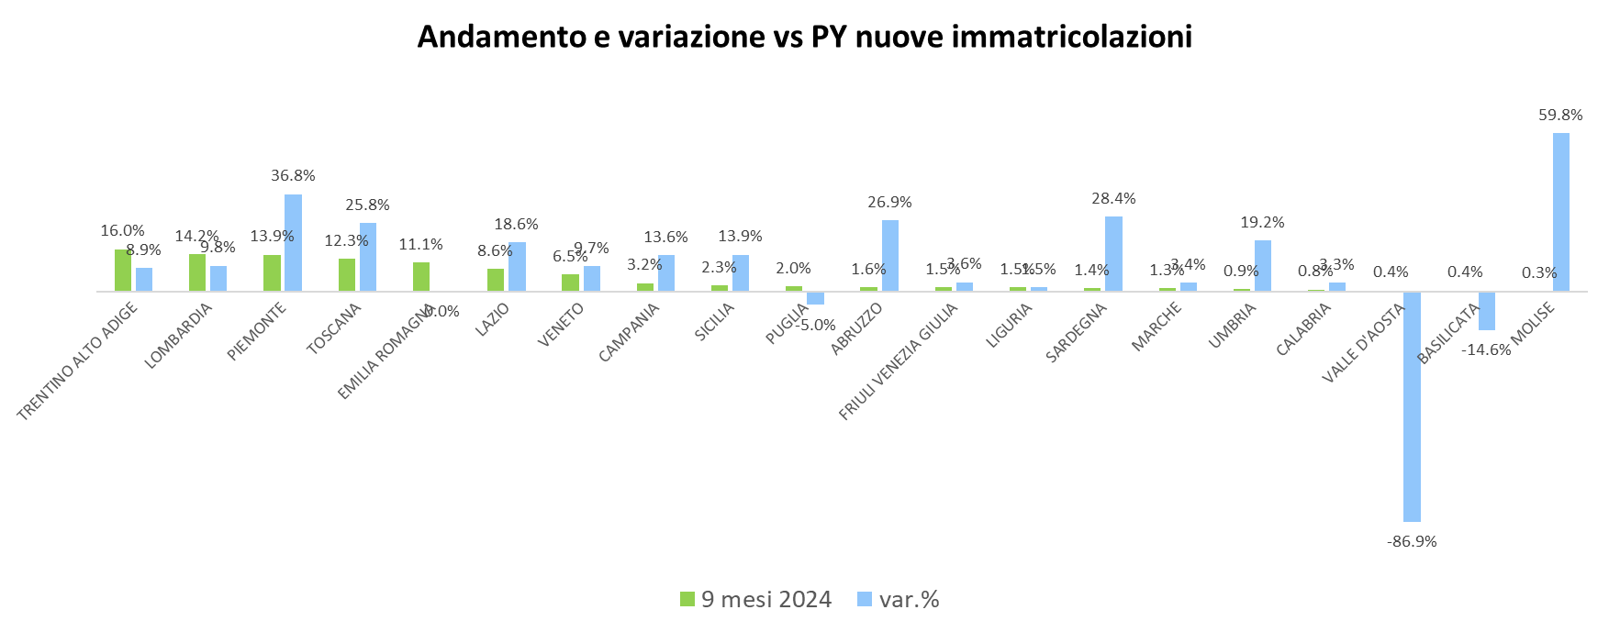
Osservatorio Credit & Mobility
Credito e Immatricolazioni
Mercato veicoli commerciali
Notes:
Text and graph slide [uses Title and Two Content layout]
The headline appears in Arial (Experian Dark Blue) at 34pt. If a subheadline is required, it should be manually sized to 20pt.
The text has five pre-set levels in 17pt Arial:
Level 1 – ranged to the left margin for continuous text; if you require a bold subheading you can embolden this to 17pt Arial Bold
Level 2 – ranged to the left text margin with a round bullet, subsequent lines aligning with the text of the previous line
Level 3 – horizontal dash bullet, subsequent lines aligning with the text of the previous line
Level 4 – round bullet, subsequent lines aligning with the text of the previous line
Level 5 –horizontal dash bullet, subsequent lines aligning with the text of the previous line
Advancing through the text levels can be done by using the ‘Increase List Level’ and ‘Decrease List Level’ buttons in the ‘Paragraph’ tools on the ‘Home’ ribbon.
If your text content exceeds the depth of the text box, you may need to consider creating an additional slide.
Working with graphs
The ‘Design’ ribbon in PowerPoint® shows a number of available graph options which are based on the colour theme of the template – always try to select a graph option and style which best communicates the data being presented. The graph ‘Design’ and ‘Format’ ribbons become available when the table has been selected, providing tools and controls directly within PowerPoint® which enable restyling and formatting of the graphic.
The brand mark on this slide layout is set up at the correct size and position and should not be altered. The date and footer info can be edited across all slides by using the ‘Header and Footer’ settings on the ‘Insert’ ribbon (do not edit these manually on the individual slides).

Slide 35
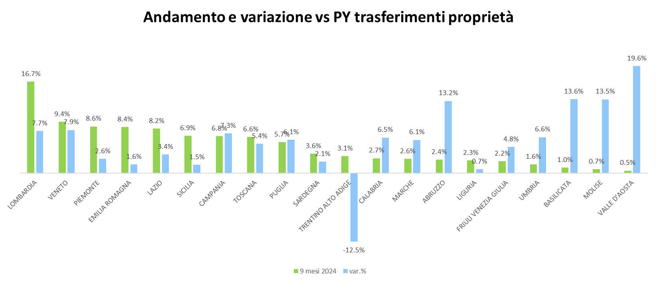
Osservatorio Credit & Mobility
Credito e Immatricolazioni
Mercato veicoli commerciali
Notes:
Text and graph slide [uses Title and Two Content layout]
The headline appears in Arial (Experian Dark Blue) at 34pt. If a subheadline is required, it should be manually sized to 20pt.
The text has five pre-set levels in 17pt Arial:
Level 1 – ranged to the left margin for continuous text; if you require a bold subheading you can embolden this to 17pt Arial Bold
Level 2 – ranged to the left text margin with a round bullet, subsequent lines aligning with the text of the previous line
Level 3 – horizontal dash bullet, subsequent lines aligning with the text of the previous line
Level 4 – round bullet, subsequent lines aligning with the text of the previous line
Level 5 –horizontal dash bullet, subsequent lines aligning with the text of the previous line
Advancing through the text levels can be done by using the ‘Increase List Level’ and ‘Decrease List Level’ buttons in the ‘Paragraph’ tools on the ‘Home’ ribbon.
If your text content exceeds the depth of the text box, you may need to consider creating an additional slide.
Working with graphs
The ‘Design’ ribbon in PowerPoint® shows a number of available graph options which are based on the colour theme of the template – always try to select a graph option and style which best communicates the data being presented. The graph ‘Design’ and ‘Format’ ribbons become available when the table has been selected, providing tools and controls directly within PowerPoint® which enable restyling and formatting of the graphic.
The brand mark on this slide layout is set up at the correct size and position and should not be altered. The date and footer info can be edited across all slides by using the ‘Header and Footer’ settings on the ‘Insert’ ribbon (do not edit these manually on the individual slides).

Slide 36
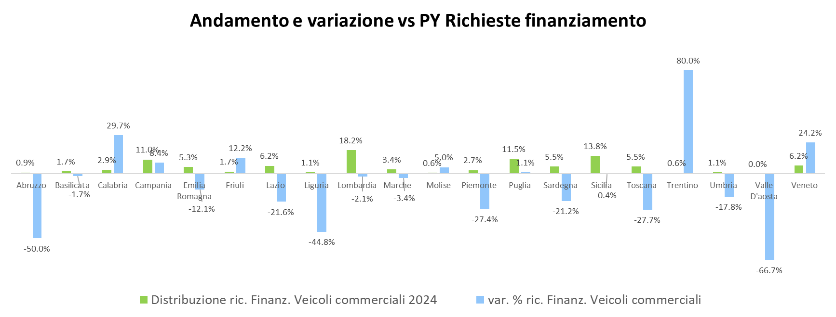
Osservatorio Credit & Mobility
Credito e Immatricolazioni
Mercato veicoli commerciali
Notes:
Text and graph slide [uses Title and Two Content layout]
The headline appears in Arial (Experian Dark Blue) at 34pt. If a subheadline is required, it should be manually sized to 20pt.
The text has five pre-set levels in 17pt Arial:
Level 1 – ranged to the left margin for continuous text; if you require a bold subheading you can embolden this to 17pt Arial Bold
Level 2 – ranged to the left text margin with a round bullet, subsequent lines aligning with the text of the previous line
Level 3 – horizontal dash bullet, subsequent lines aligning with the text of the previous line
Level 4 – round bullet, subsequent lines aligning with the text of the previous line
Level 5 –horizontal dash bullet, subsequent lines aligning with the text of the previous line
Advancing through the text levels can be done by using the ‘Increase List Level’ and ‘Decrease List Level’ buttons in the ‘Paragraph’ tools on the ‘Home’ ribbon.
If your text content exceeds the depth of the text box, you may need to consider creating an additional slide.
Working with graphs
The ‘Design’ ribbon in PowerPoint® shows a number of available graph options which are based on the colour theme of the template – always try to select a graph option and style which best communicates the data being presented. The graph ‘Design’ and ‘Format’ ribbons become available when the table has been selected, providing tools and controls directly within PowerPoint® which enable restyling and formatting of the graphic.
The brand mark on this slide layout is set up at the correct size and position and should not be altered. The date and footer info can be edited across all slides by using the ‘Header and Footer’ settings on the ‘Insert’ ribbon (do not edit these manually on the individual slides).

Slide 37
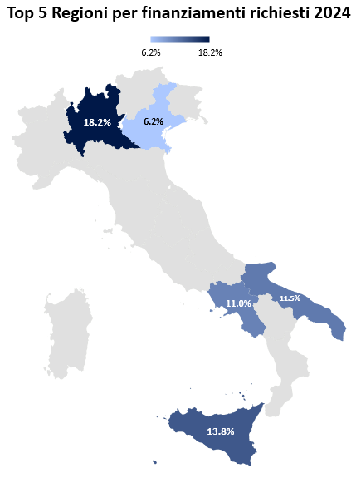
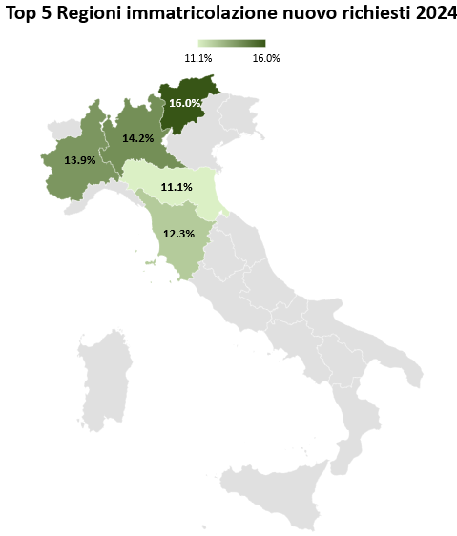
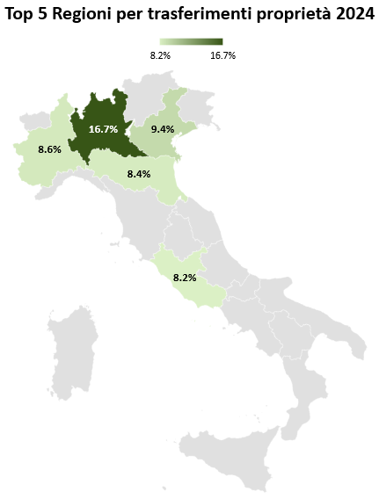
Osservatorio Credit & Mobility
Credito e Immatricolazioni
Mercato veicoli commerciali
Notes:
Text and graph slide [uses Title and Two Content layout]
The headline appears in Arial (Experian Dark Blue) at 34pt. If a subheadline is required, it should be manually sized to 20pt.
The text has five pre-set levels in 17pt Arial:
Level 1 – ranged to the left margin for continuous text; if you require a bold subheading you can embolden this to 17pt Arial Bold
Level 2 – ranged to the left text margin with a round bullet, subsequent lines aligning with the text of the previous line
Level 3 – horizontal dash bullet, subsequent lines aligning with the text of the previous line
Level 4 – round bullet, subsequent lines aligning with the text of the previous line
Level 5 –horizontal dash bullet, subsequent lines aligning with the text of the previous line
Advancing through the text levels can be done by using the ‘Increase List Level’ and ‘Decrease List Level’ buttons in the ‘Paragraph’ tools on the ‘Home’ ribbon.
If your text content exceeds the depth of the text box, you may need to consider creating an additional slide.
Working with graphs
The ‘Design’ ribbon in PowerPoint® shows a number of available graph options which are based on the colour theme of the template – always try to select a graph option and style which best communicates the data being presented. The graph ‘Design’ and ‘Format’ ribbons become available when the table has been selected, providing tools and controls directly within PowerPoint® which enable restyling and formatting of the graphic.
The brand mark on this slide layout is set up at the correct size and position and should not be altered. The date and footer info can be edited across all slides by using the ‘Header and Footer’ settings on the ‘Insert’ ribbon (do not edit these manually on the individual slides).

Slide 38
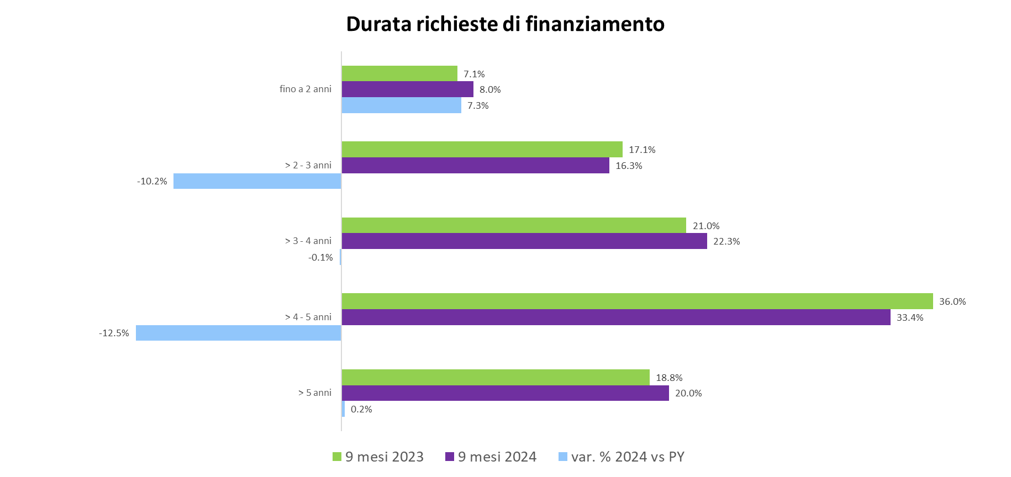
Osservatorio Credit & Mobility
Credito e Immatricolazioni
Mercato veicoli commerciali
Notes:
Text and graph slide [uses Title and Two Content layout]
The headline appears in Arial (Experian Dark Blue) at 34pt. If a subheadline is required, it should be manually sized to 20pt.
The text has five pre-set levels in 17pt Arial:
Level 1 – ranged to the left margin for continuous text; if you require a bold subheading you can embolden this to 17pt Arial Bold
Level 2 – ranged to the left text margin with a round bullet, subsequent lines aligning with the text of the previous line
Level 3 – horizontal dash bullet, subsequent lines aligning with the text of the previous line
Level 4 – round bullet, subsequent lines aligning with the text of the previous line
Level 5 –horizontal dash bullet, subsequent lines aligning with the text of the previous line
Advancing through the text levels can be done by using the ‘Increase List Level’ and ‘Decrease List Level’ buttons in the ‘Paragraph’ tools on the ‘Home’ ribbon.
If your text content exceeds the depth of the text box, you may need to consider creating an additional slide.
Working with graphs
The ‘Design’ ribbon in PowerPoint® shows a number of available graph options which are based on the colour theme of the template – always try to select a graph option and style which best communicates the data being presented. The graph ‘Design’ and ‘Format’ ribbons become available when the table has been selected, providing tools and controls directly within PowerPoint® which enable restyling and formatting of the graphic.
The brand mark on this slide layout is set up at the correct size and position and should not be altered. The date and footer info can be edited across all slides by using the ‘Header and Footer’ settings on the ‘Insert’ ribbon (do not edit these manually on the individual slides).

Slide 39
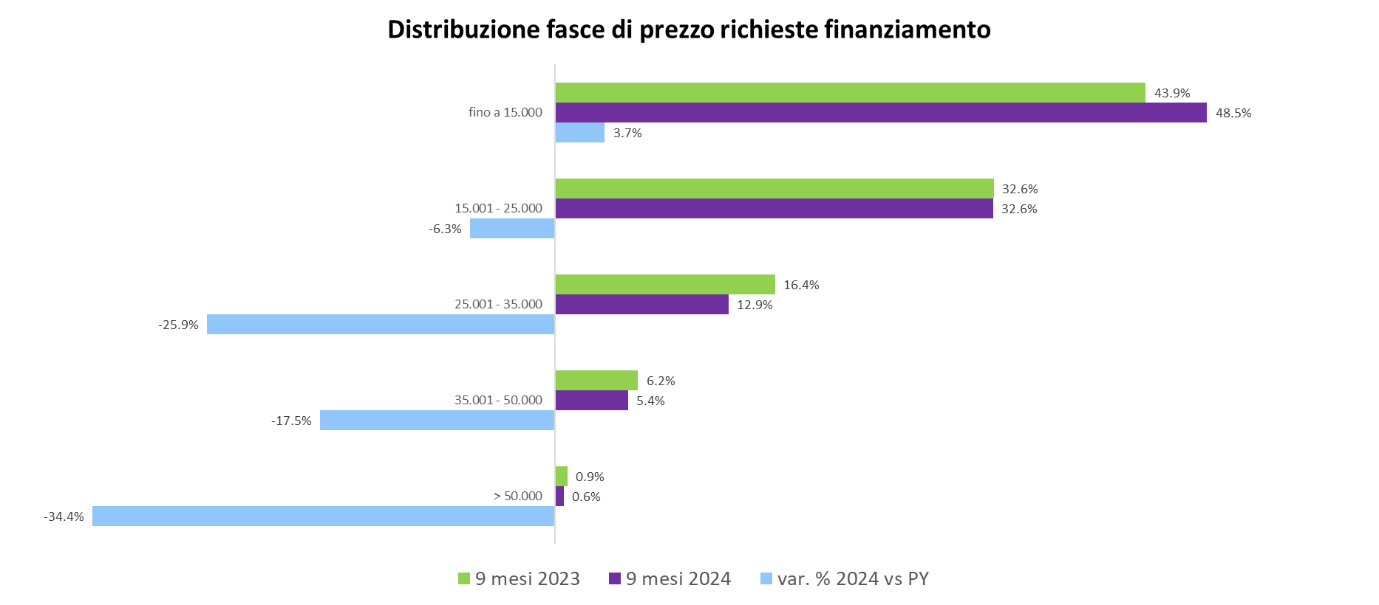
Osservatorio Credit & Mobility
Credito e Immatricolazioni
Mercato veicoli commerciali
Notes:
Text and graph slide [uses Title and Two Content layout]
The headline appears in Arial (Experian Dark Blue) at 34pt. If a subheadline is required, it should be manually sized to 20pt.
The text has five pre-set levels in 17pt Arial:
Level 1 – ranged to the left margin for continuous text; if you require a bold subheading you can embolden this to 17pt Arial Bold
Level 2 – ranged to the left text margin with a round bullet, subsequent lines aligning with the text of the previous line
Level 3 – horizontal dash bullet, subsequent lines aligning with the text of the previous line
Level 4 – round bullet, subsequent lines aligning with the text of the previous line
Level 5 –horizontal dash bullet, subsequent lines aligning with the text of the previous line
Advancing through the text levels can be done by using the ‘Increase List Level’ and ‘Decrease List Level’ buttons in the ‘Paragraph’ tools on the ‘Home’ ribbon.
If your text content exceeds the depth of the text box, you may need to consider creating an additional slide.
Working with graphs
The ‘Design’ ribbon in PowerPoint® shows a number of available graph options which are based on the colour theme of the template – always try to select a graph option and style which best communicates the data being presented. The graph ‘Design’ and ‘Format’ ribbons become available when the table has been selected, providing tools and controls directly within PowerPoint® which enable restyling and formatting of the graphic.
The brand mark on this slide layout is set up at the correct size and position and should not be altered. The date and footer info can be edited across all slides by using the ‘Header and Footer’ settings on the ‘Insert’ ribbon (do not edit these manually on the individual slides).

Slide 40
Per qualsiasi approfondimento visita i siti:
www.experian.it
www.unrae.it
Notes:
Closing slide [uses Holding Slide layout]
This slide can be used as a ‘closing’ slide and should not include any additional text or graphics. The same slide layout is used as a presentation opening slide. The brand mark and data art graphic on this slide layout are set up at the correct size and position and should not be altered.

Slide 41
Notes:
The notes that accompany these example slides form a guideline to producing successful presentations and working effectively with the template. A number of slide layout masters have been created to allow switching between different slide styles; by ‘right-clicking’ a slide you can ‘apply’ a different slide layout (the content of which needs to be applicable to the layout you are choosing).
Printing your presentation in ‘black and white’ will avoid overuse of colour toners – you can preview the ‘black and white’ appearance by choosing the option under the ‘View’ tab in PowerPoint®.
General principles
Guides have been added to assist with the correct placement of all presentation elements (text and graphics) – please work within the slide margins and use the guides wherever possible. By following the example slides you will see how elements are positioned. Text should not be resized or distorted to fit; if your content won’t fit on a single slide, use an additional slide instead. Remember… slides should be a prompt for the presenter and not filled with copy for reading out in full.
Opening slide [uses Holding Slide layout]
This slide is intended as an introductory ‘opening’ slide and should not include any additional text or graphics. The same slide layout is used as a presentation closing slide. The brand mark and data art graphic on this slide layout are set up at the correct size and position and should not be altered.

